Slide 1
CEN 3078 Computer Security
Module 2 – Application and Network Attacks

Slide 2
TCP fundamental
Attacks on the TCP protocol
Denial-of-Service attack
SQL injection attack
Cross-side scripting attack
Miscellaneous: Heartbleed bug and attack, Ransomware, Cryptojacking
Module 2

Slide 3
TCP fundamental
Attacks on the TCP protocol
Denial-of-Service attack
SQL injection attack
Cross-side scripting attack
Miscellaneous: Heartbleed bug and attack, Ransomware, Cryptojacking
Module 2

Slide 4
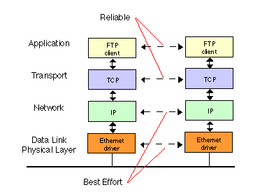
TCP Protocol
Transmission Control Protocol (TCP) is a core protocol of the Internet protocol suite
Sits on the top of the IP layer; transport layer
Provide host-to-host communication services for applications
Two transport Layer protocols
TCP: provides a reliable and ordered communication channel between applications
UDP: lightweight protocol with lower overhead and can be used for applications that do not require reliability or communication order
4

Slide 5
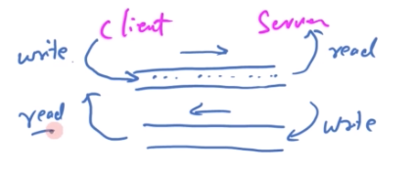
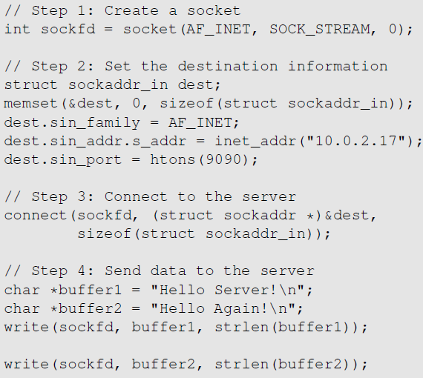
TCP Client Program
Create a socket; specify the type of communication. TCP uses SOCK_STREAM and UDP uses SOCK_DGRAM.
Initiate the TCP connection
Send data
5

Slide 6
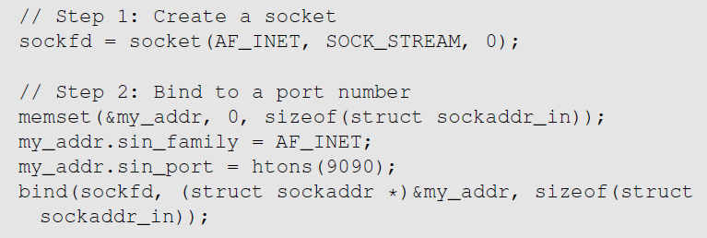
TCP Server Program
Step 1 : Create a socket. Same as Client Program.
Step 2 : Bind to a port number. An application that communicates with others over the network needs to register a port number on its host computer. When the packet arrives, the operating system knows which application is the receiver based on the port number. The server needs to tell the OS which port it is using. This is done via the bind() system call
6
Notes:
Client programs also need to register a port number. They can use bind() , but it is not necessary as the clients need to reach out to others to know what port the servers are using. Clients can leave the decision to the operating system. So, when they initiate a connection using connect(), operating systems will randomly assign a random port numbre to them.

Slide 7
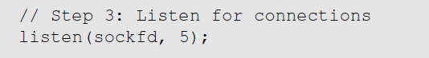
TCP Server Program
Step 3 : Listen for connections.
After the socket is set up, TCP programs call listen() to wait for connections
It tells the system that it is ready to receive connection requests.
Once a connection request is received, the operating system will go through the 3-way handshake to establish the connection
The established connection is placed in the queue, waiting for the application to take it. The second argument gives the number of connection that can be stored in the queue
7

Slide 8
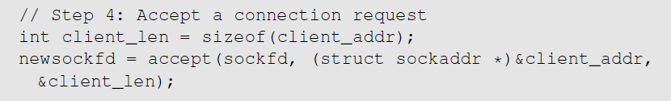
TCP Server Program
Step 4 : Accept a connection request
After the connection is established, an application needs to “accept” the connection before being able to access it. The accept() system call extracts the first connection request from the queue, creates a new socket, and returns the file descriptor referring to the socket
Step 5 : Send and Receive data
Once a connection is established and accepted, both sides can send and receive data using this new socket
8

Slide 9
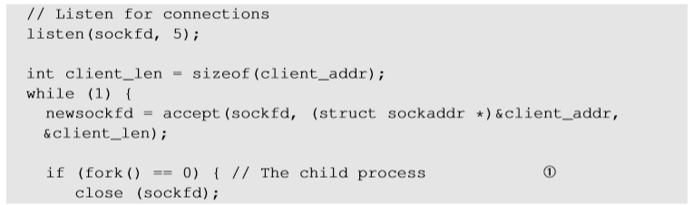
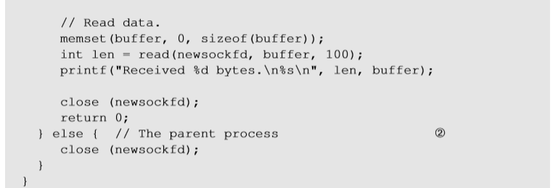
TCP Server Program
To accept multiple connections :
fork() system call creates a new process by duplicating the calling process
On success, the process ID of the child process is returned in the parent process and 0 in the child process
Line ① and Line ② executes child and parent process respectively
While loop is a connection queue – waits if there are no connections, and then if they arrive, they are processed one by one
9
Notes:
While loop is a connection queue – waits if no connections, and then if they arrive, they are processed one by one
Parent closes connection socket but delete from file descriptor table – then go back to while loop again

Slide 10
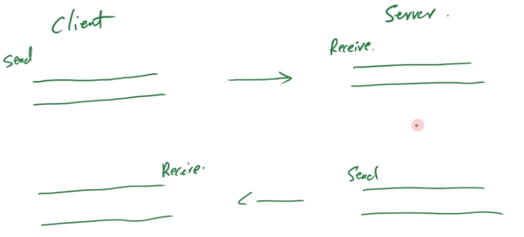
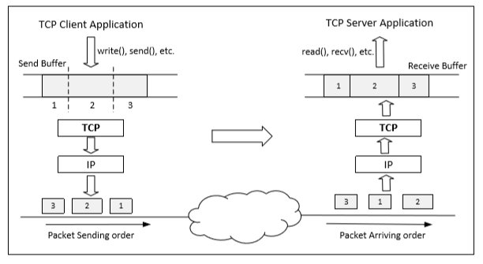
Data Transmission
Once a connection is established, OS allocates two buffers at each end, one for sending data (send buffer) and receiving buffer (receive buffer)
When an application needs to send data out, it places data into the TCP send buffer
Timing of ~200ms is used to fill the send buffer – max size of a packet you can send to Layer 2
10
Notes:
Timing 200ms to fill the send buffer – max size of a packet you can send to Layer 2

Slide 11
Data Transmission
Each octet in the send buffer has a sequence number field in the header which indicates the sequence of the packets
At the receiver end, these sequence numbers are used to place data in the right position inside receive buffer
Once data is placed in the receive buffer, they are merged into a single data stream
Applications read from the receive buffer - If no data is available, it typically gets blocked; It gets unblocked when there is enough data to read
The receiver informs the sender about receiving of data using acknowledgement packets
11
Notes:
Each packet in TCP will have different buffer on sender and sender; receiver identifies stream based on source port used by sender
Attack affects target connection, and so the elements need to be the same!

Slide 12
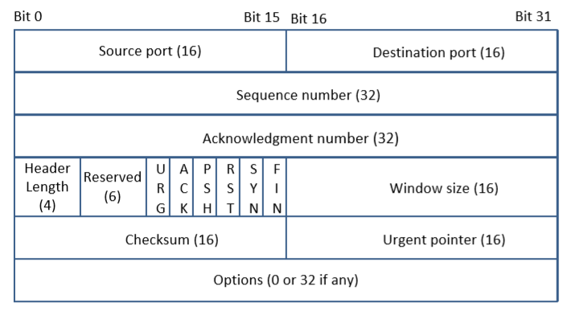
TCP Header
TCP Segment: TCP Header + Data.
Source and Destination port (16 bits each): Specify port numbers of the sender and the receiver.
Sequence number (32 bits) : Specifies the sequence number of the first octet in the TCP segment. If SYN bit is set, it is the initial sequence number.
Acknowledgement number (32 bits): Contains the value of the next sequence number expected by the sender of this segment. Valid only if ACK bit is set.
12
Notes:
TCP Sequence number # to maintain order of packets; flow/congestion control
Even if no data to send, I have to send ACK otherwise a resend will be required
TCP is bidirectional – sequence number will be different in both directions – acknowledgement is for received sequence number
6 standard bits; ACK – if turn ON/OFF it determines acknowledgement
If no options, header size is fixed
Urgent pointer – if data is urgent and do not want to put in end of header - turn ON urgent pointer that points to urgent data in packet

Slide 13
TCP Header
Header length (4 bits): Length of TCP header is measured by the number of 32-bit words in the header, so we multiply by 4 to get number of octets in the header.
Reserved (6 bits): This field is not used.
Code bits (6 bits): There are six code bits, including SYN,FIN,ACK,RST,PSH and URG.
Window (16 bits): Window advertisement to specify the number of octets that the sender of this TCP segment is willing to accept. The purpose of this field is for flow control.
Checksum (16 bits): The checksum is calculated using part of IP header, TCP header and TCP data.
Urgent Pointer (16 bits): If the URG code bit is set, the first part of the data contains urgent data (do not consume sequence numbers). The urgent pointer specifies where the urgent data ends and the normal TCP data starts. Urgent data is for priority purposes as they do not wait in line in the receive buffer, and will be delivered to the applications immediately.
Options (0-320 bits, divisible by 32): TCP segments can carry a variable length of options which provide a way to deal with the limitations of the original header.
13
Notes:
Flow Control : If one end of the connection sends data too fast, it may overwhelm the receive buffer of the other end and cause data being dropped.
By putting a smaller window value, the receiver can tell the sender to slow down.

Slide 14
Maintaining Order & Reliability
At the heart of TCP is the sliding window algorithm, but it needs to address:
Connections from many different hosts with - different RTT, different capacity at destination, long delays in network that affects order, different network capacity (i.e., congestion)
Flow control: keep sender from overrunning receiver
Congestion control: keep sender from overrunning network
Application process
Application process
Write
Read
bytes
bytes
TCP
TCP
Send buffer
Receive buffer
Segment
Segment
■ ■ ■
Segment
Transmit segments
14

Slide 15
Flow and Congestion Control
Based on flow condition, Window size is changed
Sender capacity (buffer limitation) or Network congestion (packet drop)
Sliding window + flow control
SequenceNum, Acknowledgment, AdvertisedWindow
SequenceNum: sequence # of the first byte
Receiver sends AdvertisedWindow based on available capacity
Window size is less than or equal to the minimum of AdvertisedWindow and CongestionWindow
15
Notes:
Based on flow condition window size is changed – sender capacity (buffer limitation) or network congestion (packet drop)
Flow control – how fast you can send
- Sender sends window advertisement – only 100 bytes left in buffer
- Receiver sends advertisement window size based on available capacity – and sender adjusts the window size to be less than the receiver window size advertisement
Window size chosen is min (congestion window and advertisement window)
Congestion control
Congestion window based on traffic situation

Slide 16
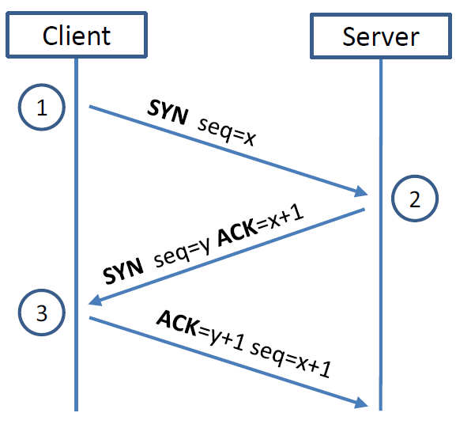
TCP 3-way Handshake Protocol
SYN Packet:
The client sends a special packet called SYN packet to the server using a randomly generated number x as its sequence number
SYN-ACK Packet:
On receiving it, the server sends a reply packet using its own randomly generated number y as its sequence number
ACK Packet
Client sends out ACK packet to conclude the handshake
Kernel establishes send and receive buffer on both sides
16
Notes:
Kernel establishes send and receive buffer on both sides

Slide 17
TCP 3-way Handshake Protocol
When the server receives the initial SYN packet, it uses TCB (Transmission Control Block) to store the information about the connection
This is called half-open connection as only client-server connection is confirmed
The server stores the TCB in a queue that is only for the half-open connection
After the server gets ACK packet, it will take this TCB out of the queue and store in a different place
If ACK doesn’t arrive, the server will resend SYN+ACK packet; The TCB will eventually be discarded after a certain time period
17
Notes:
The queue is not large, there is a limit – that creates issues
DoS attack – brute force attack won’t work for powerful server – they find Achilles heel to attack i.e., exhaust the queue with many SYN flooding packets so that there is no space for half-open connection

Slide 18
TCP 3-way Handshake Protocol
SYN Packet:
The client sends a special packet called SYN packet to the server using a randomly generated number x as its sequence number
SYN-ACK Packet:
On receiving it, the server sends a reply packet using its own randomly generated number y as its sequence number
ACK Packet
Client sends out ACK packet to conclude the handshake
Kernel establishes send and receive buffer on both sides
18
Notes:
Kernel establishes send and receive buffer on both sides

Slide 19
TCP 3-way Handshake Protocol
When the server receives the initial SYN packet, it uses TCB (Transmission Control Block) to store the information about the connection
This is called half-open connection as only client-server connection is confirmed
The server stores the TCB in a queue that is only for the half-open connection
After the server gets ACK packet, it will take this TCB out of the queue and store in a different place
If ACK doesn’t arrive, the server will resend SYN+ACK packet; The TCB will eventually be discarded after a certain time period
19
Notes:
The queue is not large, there is a limit – that creates issues
DoS attack – brute force attack won’t work for powerful server – they find Achilles heel to attack i.e., exhaust the queue with many SYN flooding packets so that there is no space for half-open connection

Slide 20
TCP fundamental
Attacks on the TCP protocol
Denial-of-Service attack
SQL injection attack
Cross-side scripting attack
Miscellaneous: Heartbleed bug and attack, Ransomware, Cryptojacking
Module 2

Slide 21
Attack on connect – TCP SYN Flooding
Attack to terminate - TCP Reset Attack
Understanding Cookies
Attack during session – TCP Hijacking Attack
Module 2
Attacks on the TCP protocol

Slide 22
Attack on connect – TCP SYN Flooding
Attack to terminate - TCP Reset Attack
Understanding Cookies
Attack during session – TCP Hijacking Attack
Module 2
Attacks on the TCP protocol

Slide 23
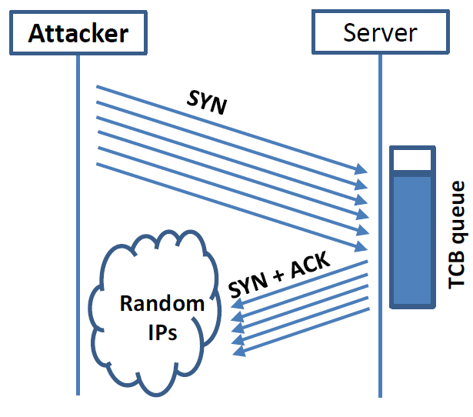
SYN Flooding Attack
Idea : To fill the queue storing the half-open connections so that there will be no space to store TCB for any new half-open connection, basically the server cannot accept any new SYN packets.
Steps to achieve this : Continuously send a lot of SYN packets to the server. This consumes the space in the queue by inserting the TCB record
Do not finish the 3rd step of handshake as it will dequeue the TCB record
When flooding the server with SYN packets, attackers use random source IP addresses; otherwise the attacks may be blocked by the firewalls…
23

Slide 24
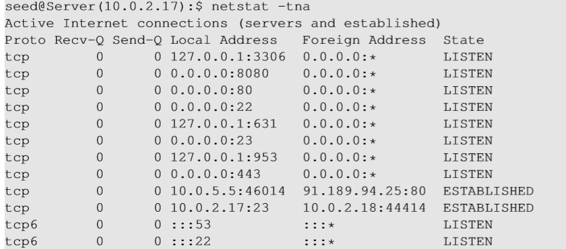
Launching SYN Flooding Attack – Before Attacking
Check the TCP states
TCP States
LISTEN: waiting for TCP connection.
ESTABLISHED: completed 3-way handshake
SYN_RECV: half-open connections
24

Slide 25
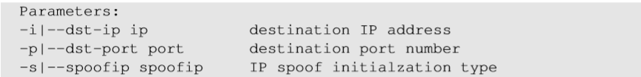
SYN Flooding Attack – Launch the Attack
Turn off the SYN Cookie countermeasure:
$sudo sysctl -w net.ipv4.tcp_syncookies=0
Targeting telnet server port 23 with SYN packets
Launch the attack using netwox
Result
Note ssh at server port 22 will still work, but not telnet
NOTE: In your SEED Lab-2, you will use Scapy for launching a SYN Flooding attack
25
Notes:
Not using Netwox but Scapy python code
https://web.ecs.syr.edu/~wedu/Teaching/cis758/netw522/netwox-doc_html/tools/76.html

Slide 26
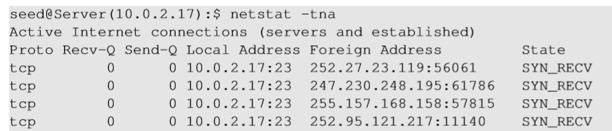
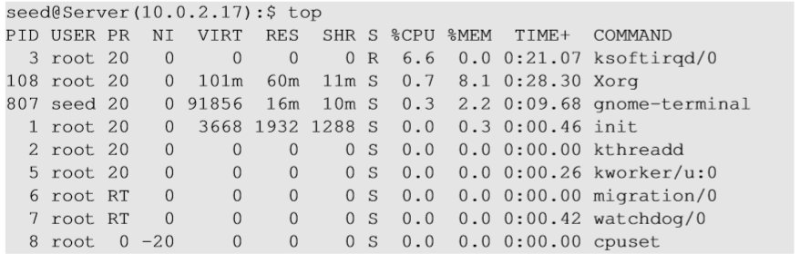
SYN Flooding Attack - Results
Using netstat command, we can see that there are a large number of half-open connections on port 23 with random source IPs
Using top command, we can see that CPU usage is not high on the server machine. The server is alive and can perform other functions normally, but cannot accept telnet connections only
26
Notes:
Attack should be done on 22 or 80 – each port SYN attack is possible – in above example, only 23 is blocked

Slide 27
Countermeasures: SYN Cookies
After a server receives a SYN packet, it calculates a keyed hash (H) from the information in the packet using a secret key that is only known to the server
This hash (H) is sent to the client as the initial sequence number from the server. H is called SYN cookie
The server will not store the half-open connection in its queue when SYN Cookie kicks-in after a certain number of SYN packets are received; instead information is put in the packet to see if it is a real connection to get information back
If the client is an attacker, H will not reach the attacker
If the client is not an attacker, it sends H+1 in the acknowledgement field
The server checks if the number in the acknowledgement field is valid or not by recalculating the cookie
27

Slide 28
Attack on connect – TCP SYN Flooding
Attack to terminate - TCP Reset Attack
Understanding Cookies
Attack during session – TCP Hijacking Attack
Module 2
Attacks on the TCP protocol

Slide 29
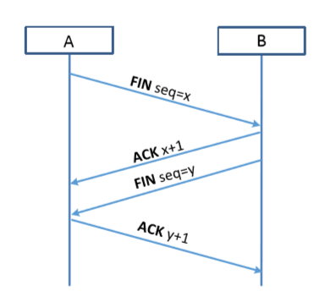
TCP Reset Attack
To disconnect a TCP connection gracefully :
A sends out a “FIN” packet to B
B replies with an “ACK” packet. This closes the A-to-B communication
Now, B sends a “FIN” packet to A and A replies with “ACK”
Using Reset flag (another way to terminate connection between A & B in abnormal/urgent situations) :
One of the parties sends RST packet to immediately break the connection
29

Slide 30
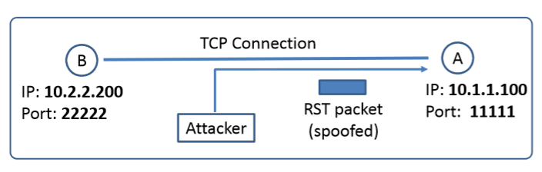
TCP Reset Attack
Goal: To break up a TCP connection between A and B
Spoofed RST Packet: The following fields need to be set correctly:
Source IP address, Source Port, Destination IP address, Destination Port (i.e., 4-Tuple to identify a TCP connection)
Sequence number (within the receiver’s window)
Fun fact: This tampering technique can be used by a firewall or abused by a malicious attacker to interrupt Internet connections.
The Great Firewall of China, and Iranian Internet censors are known to use TCP reset attacks to interfere with and block connections as a major method to carry out Internet censorship.
30

Slide 31
Attack on connect – TCP SYN Flooding
Attack to terminate - TCP Reset Attack
Understanding Cookies
Attack during session – TCP Hijacking Attack
Module 2
Attacks on the TCP protocol

Slide 32


Maintaining user/server state: cookies
Recall: HTTP GET/response interaction is stateless
no notion of multi-step exchanges of HTTP messages to complete a Web “transaction”
no need for client/server to track “state” of multi-step exchange
all HTTP requests are independent of each other
no need for client/server to “recover” from a partially-completed-but-never-completely-completed transaction
a stateful protocol: client makes two changes to X, or none at all
X
lock data record X
X
OK
update X X’
X’
OK
t’
update X X’’
OK
X’’
unlock X
OK
X’’
time
time
Q: what happens if network connection or client crashes at t’ ?
Notes:
t’

Slide 33
Maintaining user/server state: cookies
Web sites and client browser use cookies to maintain some state between transactions
four components:
1) cookie header line of HTTP response message
2) cookie header line in next HTTP request message
3) cookie file kept on user’s host, managed by user’s browser
4) back-end database at Web site
Example:
Susan uses browser on laptop, visits specific e-commerce site for first time
when initial HTTP requests arrives at site, site creates:
unique ID (aka “cookie”)
entry in backend database for ID
subsequent HTTP requests from Susan to this site will contain cookie ID value, allowing site to “identify” Susan
Notes:
t’

Slide 34
Maintaining user/server state: cookies
client
Amazon server
ebay 8734
usual HTTP request msg
Amazon server
creates ID
1678 for user
cookie file
usual HTTP response
set-cookie: 1678
backend
database
create
entry
ebay 8734
amazon 1678
usual HTTP request msg
cookie: 1678
cookie-
specific
action
access
usual HTTP response msg
one week later:
access
ebay 8734
amazon 1678
usual HTTP request msg
cookie: 1678
cookie-
specific
action
usual HTTP response msg
time
time
Notes:
t’

Slide 35
HTTP cookies: comments
aside
What cookies can be used for:
authorization
shopping carts
recommendations
user session state (Web e-mail)
cookies and privacy:
cookies permit sites to learn a lot about you on their site.
third party persistent cookies (tracking cookies) allow common identity (cookie value) to be tracked across multiple web sites
Challenge: How to keep state?
at protocol endpoints: maintain state at sender/receiver over multiple transactions
in messages: cookies in HTTP messages carry state
Notes:
t’

Slide 36




Example: displaying a NY Times web page
1
GET base html file from nytimes.com
2
fetch ad from AdX.com
nytimes.com
4
5
HTTP GET
1
2
HTTP reply
7
display composed page
3
4
6
5
NY times page with embedded ad displayed
AdX.com

Slide 37
Cookies: tracking a user’s browsing behavior
1634: sports, 2/15/22
nytimes.com (sports)
“first party” cookie – from website you chose to visit (provides base html file)
HTTP
GET
HTTP reply
Set cookie: 1634
HTTP GET
Referrer: NY Times Sports
4
5
7493: NY Times sports, 2/15/22
“third party” cookie – from website you did not choose to visit
HTTP reply
NY Times: 1634
Set cookie: 7493
AdX.com
AdX: 7493

Slide 38
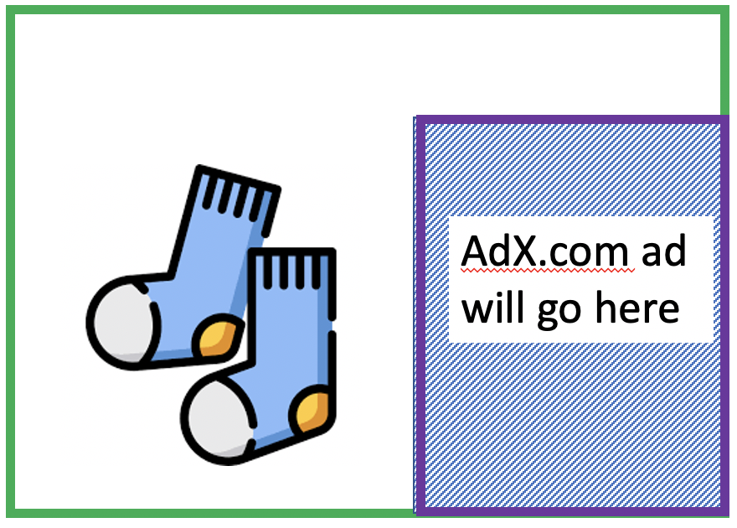
Cookies: tracking a user’s browsing behavior
1634: sports, 2/15/22
nytimes.com
AdX:
tracks my web browsing over sites with AdX ads
can return targeted ads based on browsing history
socks.com
HTTP reply
2
HTTP GET
1
HTTP GET
Referrer: socks.com, cookie: 7493
4
7493: NY Times sports, 2/15/22
5
7493: socks.com, 2/16/22
HTTP reply
NY Times: 1634
Set cookie: 7493
AdX.com
AdX: 7493

Slide 39

Cookies: tracking a user’s browsing behavior (one day later)
1634: sports, 2/15/22
1634: arts, 2/17/22
nytimes.com (arts)
socks.com
HTTP
GET
HTTP reply
cookie: 1634
Set cookie: 1634
HTTP GET
Referrer: nytimes.com, cookie: 7493
4
7493: NY Times sports, 2/15/22
5
7493: socks.com, 2/16/22
HTTP reply
7493: NY Times arts, 2/15/22
NY Times: 1634
Set cookie: 7493
AdX.com
AdX: 7493
Returned ad for socks!

Slide 40


GDPR (EU General Data Protection Regulation) and cookies
“Natural persons may be associated with online identifiers […] such as internet protocol addresses, cookie identifiers or other identifiers […].
This may leave traces which, in particular when combined with unique identifiers and other information received by the servers, may be used to create profiles of the natural persons and identify them.”
GDPR, recital 30 (May 2018)
when cookies can identify an individual, cookies are considered personal data, subject to GDPR personal data regulations
User has explicit control over whether or not cookies are allowed

Slide 41
Attack on connect – TCP SYN Flooding
Attack to terminate - TCP Reset Attack
Understanding Cookies
Attack during session – TCP Hijacking Attack
Module 2
Attacks on the TCP protocol

Slide 42
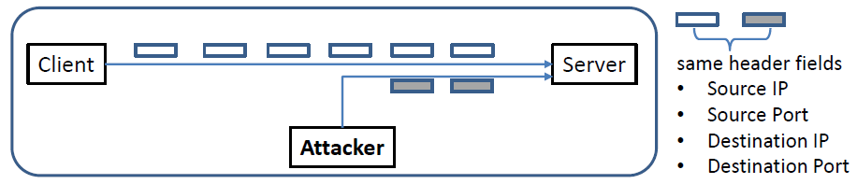
TCP Session Hijacking Attack
Goal: To inject data in an established connection.
(This is different from the DoS attack in TCP SYN Flooding or Reset)
Spoofed TCP Packet: The following fields need to be set correctly:
Source IP address, Source Port,
Destination IP address, Destination Port
Sequence number (within the receiver’s window)
42

Slide 43
TCP Session Hijacking Attack Examples
Zoom bombing
During the Covid-19 pandemic, the world turned to video conferencing apps like Zoom. These apps became a popular target of session hijackers, even earning the nickname ‘zoom bombing’. There were news reports of session hijackers joining private video sessions, in some cases shouting profanities, hateful language and sharing pornographic images. In response, Zoom introduced greater privacy protections to minimize the risk.
Slack
In 2019, a researcher on a bug bounty platform identified a vulnerability in Slack which allowed attackers to force users into fake session redirects so they could steal their session cookies. This gave attackers access to any data shared within Slack (which for many organizations, can be significant). Slack was quick to respond and patched the vulnerability within 24 hours of the researcher highlighting it.

Slide 44
Defending Against Session Hijacking
Making it difficult for attackers to spoof packets
Randomize source port number
Randomize initial sequence number
Note: Randomization is NOT effective against local attacks that can sniff packets and determine this information
Encrypting payload
44

Slide 45
TCP fundamental
Attacks on the TCP protocol
Denial-of-Service attack
SQL injection attack
Cross-side scripting attack
Miscellaneous: Heartbleed bug and attack, Ransomware, Cryptojacking
Module 2

Slide 46
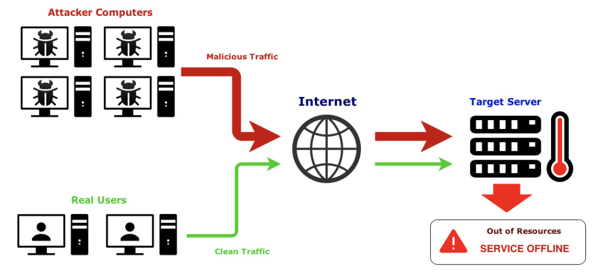
Denial-of-Service (DoS) Attack
A denial of service (DoS) is an action that prevents or impairs the authorized use of networks, systems, or applications by exhausting resources such as central processing units (CPU), memory, bandwidth, and disk space
A form of attack on the availability of a service; focus is generally on network services that are attacked over their network connection
46

Slide 47
DoS Attack - Facts
One of the most common types of attacks
Aims to prevent users from accessing system
Requires a minimum of technical skill
Effective because computers and other systems have physical limitations
Number of simultaneous users
Size of files
Speed of data transmission
Amount of data stored

Slide 48
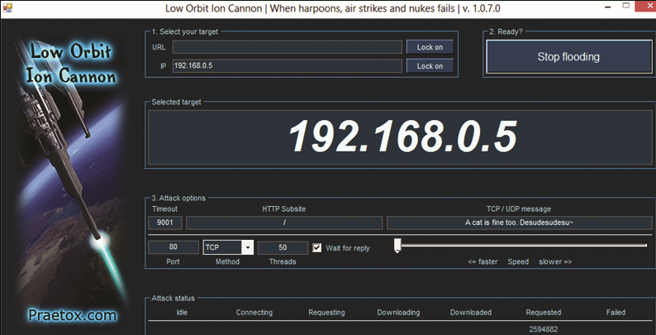
Common Tools Used for DoS Attacks
Low Orbit Ion Cannon (LOIC)

Slide 49

Common Tools Used for DoS Attacks
High Orbit Ion Cannon (HOIC)

Slide 50
Denial-of-Service (DoS) Attack Categories
Network bandwidth
Relates to the capacity of the network links connecting a server to the Internet
For most organizations this is their connection to their Internet Service Provider (ISP)
System resources
Aims to overload or trigger a bug to crash the network handling software using ‘poison packets’
Application resources
‘Cyberslam’ involving a number of valid requests (e.g., db query), each of which consumes significant resources, thus limiting the ability of the server to respond to requests from legitimate users
50
Notes:
From this definition, you can see that there are several categories of resources
that could be attacked:
• Network bandwidth
• System resources
• Application resources
Network bandwidth relates to the capacity of the network links connecting a server
to the wider Internet. For most organizations, this is their connection to their Internet
service provider (ISP), as shown in the example network in Figure 7.1. Usually this
connection will have a lower capacity than the links within and between ISP routers.
This means it is possible for more traffic to arrive at the ISP’s routers over these
higher-capacity links than can be carried over the link to the organization. In this
circumstance, the router must discard some packets, delivering only as many as can
be handled by the link. In normal network operation such high loads might occur
to a popular server experiencing traffic from a large number of legitimate users. A
random portion of these users will experience a degraded or nonexistent service as
a consequence. This is expected behavior for an overloaded TCP/IP network link.
In a DoS attack, the vast majority of traffic directed at the target server is malicious,
generated either directly or indirectly by the attacker. This traffic overwhelms
any legitimate traffic, effectively denying legitimate users access to the server. Some
recent high volume attacks have even been directed at the ISP network supporting
the target organization, aiming to disrupt its connections to other networks. A number
of recent DDoS attacks are listed in [AROR11], with comments on their growth
in volume and impact.
A DoS attack targeting system resources typically aims to overload or crash its
network handling software. Rather than consuming bandwidth with large volumes
of traffic, specific types of packets are sent that consume the limited resources available
on the system. These include temporary buffers used to hold arriving packets,
tables of open connections, and similar memory data structures. The SYN spoofing
attack, which we discuss next, is of this type. It targets the table of TCP connections
on the server.
Another form of system resource attack uses packets whose structure triggers
a bug in the system’s network handling software, causing it to crash. This means the
system can no longer communicate over the network until this software is reloaded,
generally by rebooting the target system. This is known as a poison packet . The
classic ping of death and teardrop attacks, directed at older Windows 9x systems,
were of this form. These targeted bugs in the Windows network code that handled
ICMP (Internet Control Message Protocol) echo request packets and packet fragmentation,
respectively.
An attack on a specific application, such as a Web server, typically involves a
number of valid requests, each of which consumes significant resources. This then
limits the ability of the server to respond to requests from other users. For example,
a Web server might include the ability to make database queries. If a large,
costly query can be constructed, then an attacker could generate a large number of
these that severely load the server. This limits its ability to respond to valid requests
from other users. This type of attack is known as a cyberslam . [KAND05] discusses
attacks of this kind, and suggests some possible countermeasures. Another
alternative is to construct a request that triggers a bug in the server program, causing
it to crash. This means the server is no longer able to respond to requests until
it is restarted.
DoS attacks may also be characterized by how many systems are used to direct
traffic at the target system. Originally only one, or a small number of source systems
directly under the attacker’s control, was used. This is all that is required to send the
packets needed for any attack targeting a bug in a server’s network handling code or
some application. Attacks requiring high traffic volumes are more commonly sent
from multiple systems at the same time, using distributed or amplified forms of DoS
attacks. We discuss these later in this chapter.

Slide 51
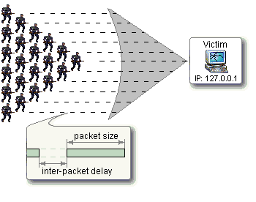
Classic DoS Attacks
Flooding ping command
Aim of this attack is to overwhelm the capacity of the network connection to the target organization
Traffic can be handled by higher capacity links on the path, but packets are discarded as capacity decreases
Source of the attack is clearly identified (e.g., in ICMP echo request) unless a spoofed address is used - attacker might use a large company’s Web server to target a medium-sized company with a lower-capacity network connection
Network performance is noticeably affected
Defense: Load balancers, firewalls
51
Notes:
The simplest classical DoS attack is a flooding attack on an organization. The aim
of this attack is to overwhelm the capacity of the network connection to the target
organization. If the attacker has access to a system with a higher-capacity network
connection, then this system can likely generate a higher volume of traffic than the
lower-capacity target connection can handle. For example, in the network shown
in Figure 7.1 , the attacker might use the large company’s Web server to target the
medium-sized company with a lower-capacity network connection. The attack might
be as simple as using a flooding ping command directed at the Web server in the
target company. This traffic can be handled by the higher-capacity links on the path
between them, until the final router in the Internet cloud is reached. At this point
some packets must be discarded, with the remainder consuming most of the capacity
on the link to the medium-sized company. Other valid traffic will have little chance
of surviving discard as the router responds to the resulting congestion on this link.
In this classic ping flood attack, the source of the attack is clearly identified
since its address is used as the source address in the ICMP echo request packets. This
has two disadvantages from the attacker’s perspective. First, the source of the attack
is explicitly identified, increasing the chance that the attacker can be identified and
legal action taken in response. Second, the targeted system will attempt to respond to
the packets being sent. In the case of any ICMP echo request packets received by the
server, it would respond to each with an ICMP echo response packet directed back
to the sender. This effectively reflects the attack back at the source system. Since
the source system has a higher network bandwidth, it is more likely to survive this
reflected attack. However, its network performance will be noticeably affected, again
increasing the chances of the attack being detected and action taken in response. For
both of these reasons the attacker would like to hide the identity of the source system.
This means that any such attack packets need to use a falsified, or spoofed, address.

Slide 52
Flooding Attacks
Classified based on network protocol used
Intent is to overload the network capacity on some link to a server
Virtually any type of network packet can be used
ICMP flood
Ping flood using ICMP echo request packets
Traditionally network administrators allow such packets into their networks because ping is a useful network diagnostic tool
UDP flood
Uses UDP packets directed to some port number on the target system
TCP SYN flood
Sends TCP packets to the target system
High volume of packets to attack the network handling code in the operating system; denies legitimate user access
52
Notes:
Flooding attacks take a variety of forms, based on which network protocol is being
used to implement the attack. In all cases the intent is generally to overload the
network capacity on some link to a server. The attack may alternatively aim to
overload the server’s ability to handle and respond to this traffic. These attacks flood
the network link to the server with a torrent of malicious packets competing with, and
usually overwhelming, valid traffic flowing to the server. In response to the congestion
this causes in some routers on the path to the targeted server, many packets will be
dropped. Valid traffic has a low probability of surviving discard caused by this flood
and hence of accessing the server. This results in the server’s ability to respond to
network connection requests being either severely degraded or failing entirely.
Virtually any type of network packet can be used in a flooding attack. It simply
needs to be of a type that is permitted to flow over the links toward the targeted system,
so that it can consume all available capacity on some link to the target server. Indeed,
the larger the packet, the more effective is the attack. Common flooding attacks use
any of the ICMP, UDP, or TCP SYN packet types. It is even possible to flood with
some other IP packet type. However, as these are less common and their usage more
targeted, it is easier to filter for them and hence hinder or block such attacks.
The ping flood using ICMP echo request packets we discuss in Section 7.1 is a classic
example of an ICMP flooding attack. This type of ICMP packet was chosen since
traditionally network administrators allowed such packets into their networks, as
ping is a useful network diagnostic tool. More recently, many organizations have
restricted the ability of these packets to pass through their firewalls. In response,
attackers have started using other ICMP packet types. Since some of these should
be handled to allow the correct operation of TCP/IP, they are much more likely to
be allowed through an organization’s firewall. Filtering some of these critical ICMP
packet types would degrade or break normal TCP/IP network behavior. ICMP
destination unreachable and time exceeded packets are examples of such critical
packet types.
An attacker can generate large volumes of one of these packet types. Because
these packets include part of some notional erroneous packet that supposedly caused
the error being reported, they can be made comparatively large, increasing their effectiveness
in flooding the link. ICMP flood attacks remain one of the most common
types of DDoS attacks [SYMA16].
An alternative to using ICMP packets is to use UDP packets directed to some port
number, and hence potential service, on the target system. A common choice was a
packet directed at the diagnostic echo service, commonly enabled on many server
systems by default. If the server had this service running, it would respond with a
UDP packet back to the claimed source containing the original packet data contents.
If the service is not running, then the packet is discarded, and possibly an
ICMP destination unreachable packet is returned to the sender. By then the attack
has already achieved its goal of occupying capacity on the link to the server. Just
about any UDP port number can be used for this end. Any packets generated in
response only serve to increase the load on the server and its network links.
Spoofed source addresses are normally used if the attack is generated using
a single source system, for the same reasons as with ICMP attacks. If multiple systems
are used for the attack, often the real addresses of the compromised, zombie,
systems are used. When multiple systems are used, the consequences of both the
reflected flow of packets and the ability to identify the attacker are reduced.
Another alternative is to send TCP packets to the target system. Most likely these
would be normal TCP connection requests, with either real or spoofed source
addresses. They would have an effect similar to the SYN spoofing attack we’ve
described. In this case, though, it is the total volume of packets that is the aim of the
attack rather than the system code. This is the difference between a SYN spoofing
attack and a SYN flooding attack.
This attack could also use TCP data packets, which would be rejected by the
server as not belonging to any known connection. But again, by this time the attack
has already succeeded in flooding the links to the server.
All of these flooding attack variants are limited in the total volume of traffic
that can be generated if just a single system is used to launch the attack. The use
of a single system also means the attacker is easier to trace. For these reasons, a
variety of more sophisticated attacks, involving multiple attacking systems, have
been developed. By using multiple systems, the attacker can significantly scale up
the volume of traffic that can be generated. Each of these systems need not be particularly
powerful or on a high-capacity link. But what they don’t have individually,
they more than compensate for in large numbers. Also, by directing the attack
through intermediaries, the attacker is further distanced from the target and significantly
harder to locate and identify. Indirect attack types that utilize multiple
systems include
• Distributed denial-of-service attacks
• Reflector attacks
• Amplifier attacks
We consider each of these in turn.

Slide 53
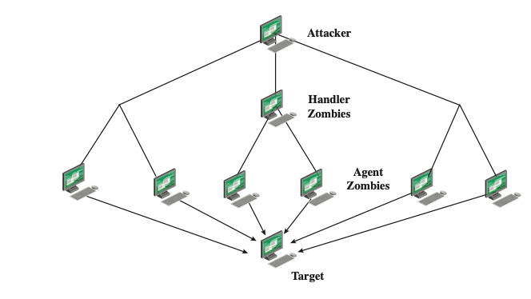
Distributed DoS (DDoS) Attacks
Use of multiple systems to generate flooding attacks
Attacker uses a flaw in operating system or in a common application to gain access and installs their zombie program on it
Large collections of such systems under the control of one attacker’s control can be created, forming a botnet
53
Notes:
Recognizing the limitations of flooding attacks generated by a single system, one
of the earlier significant developments in DoS attack tools was the use of multiple
systems to generate attacks. These systems were typically compromised user workstations
or PCs. The attacker uses malware to subvert the system and to install an attack
agent, which they can control. Such systems are known as zombies. Large collections
of such systems under the control of one attacker can be created, collectively forming
a botnet , as we discussed in Chapter 6. Such networks of compromised systems
are a favorite tool of attackers, and can be used for a variety of purposes, including
distributed denial-of-service (DDoS) attacks. Indeed, there is an underground
economy that creates and hires out botnets for use in such attacks. [SYMA16] report
evidence that 40% of DDoS attacks in 2015 were from such botnets for hire. In the
example network shown in Figure 7.1, some of the broadband user systems may be
compromised and used as zombies to attack any of the company or other links shown.
Many other DDoS tools have been developed since. Instead of using dedicated
handler programs, many now use an IRC or similar instant messaging server
program to manage communications with the agents. Many of these more recent
tools also use cryptographic mechanisms to authenticate the agents to the handlers,
in order to hinder analysis of command traffic.
The best defense against being an unwitting participant in a DDoS attack is to
prevent your systems from being compromised. This requires good system security
practices and keeping the operating systems and applications on such systems current
and patched.
For the target of a DDoS attack, the response is the same as for any flooding
attack, but with greater volume and complexity. We discuss appropriate defenses
and responses in Sections 7.6 and 7.7.

Slide 54
Hypertext Transfer Protocol (HTTP) Based Attacks
HTTP flood attack
Attack that bombards Web servers with HTTP requests
Consumes considerable resources
Spidering - Bots start from a given HTTP link and follow all links on the provided Web site in a recursive way
Slowloris attack
Attempts to monopolize a server’s multi-threading by sending HTTP requests that never complete
Eventually consumes Web server’s connection capacity
Utilizes legitimate HTTP traffic
Existing intrusion detection and prevention solutions that rely on signatures to detect attacks will generally not recognize Slowloris
Rate limiting number of host connections can help defend or delayed binding can be done by a load balancer to ensure web server or proxy will not see incomplete requests
54
Notes:
We consider two different approaches to exploiting the Hypertext Transfer Protocol
(HTTP) to deny service.
An HTTP flood refers to an attack that bombards Web servers
with HTTP requests. Typically, this is a DDoS attack, with HTTP requests coming
from many different bots. The requests can be designed to consume considerable
resources. For example, an HTTP request to download a large file from the target
causes the Web server to read the file from hard disk, store it in memory, convert it
into a packet stream, and then transmit the packets. This process consumes memory,
processing, and transmission resources.
A variant of this attack is known as a recursive HTTP flood. In this case, the
bots start from a given HTTP link and then follows all links on the provided Web
site in a recursive way. This is also called spidering.
An intriguing and unusual form of HTTP-based attack is Slowloris
[SOUR12], [DAMO12]. Slowloris exploits the common server technique of using
multiple threads to support multiple requests to the same server application. It
attempts to monopolize all of the available request handling threads on the Web
server by sending HTTP requests that never complete. Since each request consumes
a thread, the Slowloris attack eventually consumes all of the Web server’s connection
capacity, effectively denying access to legitimate users.
The HTTP protocol specification (RFC2616) states that a blank line must be
used to indicate the end of the request headers and the beginning of the payload,
if any. Once the entire request is received, the Web server may then respond. The
Slowloris attack operates by establishing multiple connections to the Web server.
On each connection, it sends an incomplete request that does not include the terminating
newline sequence. The attacker sends additional header lines periodically to
keep the connection alive, but never sends the terminating newline sequence. The
Web server keeps the connection open, expecting more information to complete
the request. As the attack continues, the volume of long-standing Slowloris connections
increases, eventually consuming all available Web server connections, thus
rendering the Web server unavailable to respond to legitimate requests.
Slowloris is different from typical denials of service in that Slowloris traffic
utilizes legitimate HTTP traffic, and does not rely on using special “bad” HTTP
requests that exploit bugs in specific HTTP servers. Because of this, existing intrusion
detection and intrusion prevention solutions that rely on signatures to detect
attacks will generally not recognize Slowloris. This means that Slowloris is capable
of being effective even when standard enterprise-grade intrusion detection and
intrusion prevention systems are in place.
There are a number of countermeasures that can be taken against Slowloris
type attacks, including limiting the rate of incoming connections from a particular
host; varying the timeout on connections as a function of the number of connections;
and delayed binding. Delayed binding is performed by load balancing software. In
essence, the load balancer performs an HTTP request header completeness check,
which means that the HTTP request will not be sent to the appropriate Web server
until the final two carriage return and line feeds are sent by the HTTP client. This is
the key bit of information. Basically, delayed binding ensures that your Web server
or proxy will never see any of the incomplete requests being sent out by Slowloris.

Slide 55
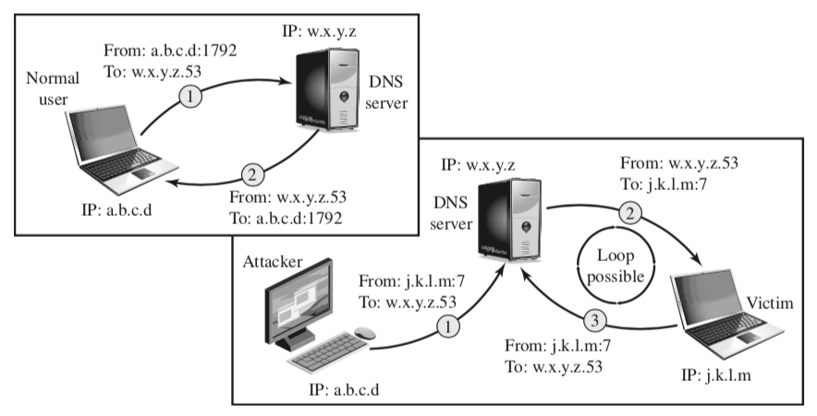
DNS Reflection Attack
Reflector attack establishes a self-contained loop between the intermediary and the target system; Both systems act as reflectors
Most reflector attacks can be prevented through network-based and host-based firewall rulesets that reject suspicious combinations of source and destination ports
The attacker sends a query to the DNS server with a spoofed IP source address of j.k.l.m; this is the IP address of the target. The attacker uses port 7, which is usually associated with echo, a reflector service. The DNS server then sends a response to the victim of the attack, j.k.l.m, addressed to port 7. If the victim is offering the echo service, it may create a packet that echoes the received data back to the DNS server. This can cause a loop between the DNS server and the victim.
Normal DNS Operation
DNS Operation under Attack
The DNS client sends a query from its UDP port 1792 to the server’s DNS port 53 to obtain the IP address of a domain name. The DNS server sends a UDP response packet including the IP address.
55
Notes:
A further variation of the reflector attack establishes a self-contained loop
between the intermediary and the target system. Both systems act as reflectors.
Figure 7.6 shows this type of attack. The upper part of the figure shows normal
Domain Name System operation. The DNS client sends a query from its UDP
port 1792 to the server’s DNS port 53 to obtain the IP address of a domain name.
The DNS server sends a UDP response packet including the IP address. The lower
part of the figure shows a reflection attack using DNS. The attacker sends a query
to the DNS server with a spoofed IP source address of j.k.l.m; this is the IP address
of the target. The attacker uses port 7, which is usually associated with echo, a
reflector service. The DNS server then sends a response to the victim of the attack,
j.k.l.m, addressed to port 7. If the victim is offering the echo service, it may create a
packet that echoes the received data back to the DNS server. This can cause a loop
between the DNS server and the victim if the DNS server responds to the packets
sent by the victim. Most reflector attacks can be prevented through network-based
and host-based firewall rulesets that reject suspicious combinations of source and
destination ports.
While very effective if possible, this type of attack is fairly easy to filter for
because the combinations of service ports used should never occur in normal network
operation.
When implementing any of these reflection attacks, the attacker could use just
one system as the original source of packets. This suffices, particularly if a service
is used that generates larger response packets than those originally sent to the intermediary.
Alternatively, multiple systems might be used to generate higher volumes
of traffic to be reflected and to further obscure the path back to the attacker. Typically a botnet
would be used in this case.
Another characteristic of reflection attacks is the lack of backscatter traffic.
In both direct flooding attacks and SYN spoofing attacks, the use of spoofed
source addresses results in response packets being scattered across the Internet and
thus detectable. This allows security researchers to estimate the volumes of such
attacks. In reflection attacks, the spoofed source address directs all the packets at
the desired target and any responses to the intermediary. There is no generally visible
side effect of these attacks, making them much harder to quantify. Evidence of
them is only available from either the targeted systems and their ISPs or the intermediary
systems. In either case, specific instrumentation and monitoring would be
needed to collect this evidence.
Fundamental to the success of reflection attacks is the ability to create
spoofed-source packets. If filters are in place that block spoofed-source packets, as
described in (RFC 2827), then these attacks are simply not possible. This is the most
basic, fundamental defense against such attacks. This is not the case with either
SYN spoofing or flooding attacks (distributed or not). They can succeed using real
source addresses, with the consequences already noted.

Slide 56
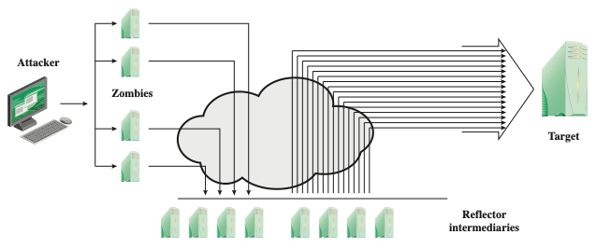
Amplification Attacks
They are a variant of reflector attacks and also involve sending a packet with a spoofed source address for the target system to intermediaries
They differ in generating multiple response packets for each original packet sent; this can be achieved by directing the original request to the broadcast address for some network; as a result, all hosts on that network can potentially respond to the request, generating a flood of responses to a victim (spoofed) IP address
It is only necessary to use a service handled by large numbers of hosts on the intermediate network; the well-known Smurf DoS program used ping flood mechanism using ICMP echo request packets
The best additional defense against this form of attack is to not allow directed broadcasts to be routed into a network from outside
56
Notes:
Amplification attacks are a variant of reflector attacks and also involve sending a
packet with a spoofed source address for the target system to intermediaries. They
differ in generating multiple response packets for each original packet sent. This can
be achieved by directing the original request to the broadcast address for some network.
As a result, all hosts on that network can potentially respond to the request,
generating a flood of responses as shown in Figure 7.7 . It is only necessary to use
a service handled by large numbers of hosts on the intermediate network. A ping
flood using ICMP echo request packets was a common choice, since this service
is a fundamental component of TCP/IP implementations and was often allowed
into networks. The well-known smurf DoS program used this mechanism and was
widely popular for some time. Another possibility is to use a suitable UDP service,
such as the echo service. The fraggle program implemented this variant. Note that
TCP services cannot be used in this type of attack; because they are connection
oriented, they cannot be directed at a broadcast address. Broadcasts are inherently
connectionless.
The best additional defense against this form of attack is to not allow directed
broadcasts to be routed into a network from outside. Indeed, this is another longstanding
security recommendation, unfortunately about as widely implemented as
that for blocking spoofed source addresses. If these forms of filtering are in place,
these attacks cannot succeed. Another defense is to limit network services like echo
and ping from being accessed from outside an organization. This restricts which
services could be used in these attacks, at a cost in ease of analyzing some legitimate
network problems.
Attackers scan the Internet looking for well-connected networks that do allow
directed broadcasts and that implement suitable services attackers can reflect off.
These lists are traded and used to implement such attacks.

Slide 57
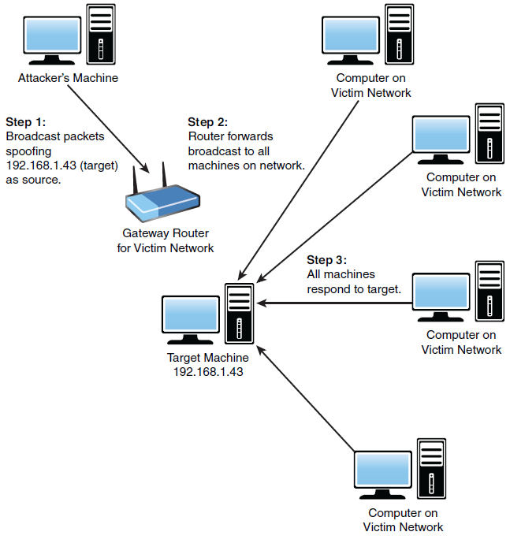
Amplification Attacks cont.
Smurf Attack
57
Notes:
Amplification attacks are a variant of reflector attacks and also involve sending a
packet with a spoofed source address for the target system to intermediaries. They
differ in generating multiple response packets for each original packet sent. This can
be achieved by directing the original request to the broadcast address for some network.
As a result, all hosts on that network can potentially respond to the request,
generating a flood of responses as shown in Figure 7.7 . It is only necessary to use
a service handled by large numbers of hosts on the intermediate network. A ping
flood using ICMP echo request packets was a common choice, since this service
is a fundamental component of TCP/IP implementations and was often allowed
into networks. The well-known smurf DoS program used this mechanism and was
widely popular for some time. Another possibility is to use a suitable UDP service,
such as the echo service. The fraggle program implemented this variant. Note that
TCP services cannot be used in this type of attack; because they are connection
oriented, they cannot be directed at a broadcast address. Broadcasts are inherently
connectionless.
The best additional defense against this form of attack is to not allow directed
broadcasts to be routed into a network from outside. Indeed, this is another longstanding
security recommendation, unfortunately about as widely implemented as
that for blocking spoofed source addresses. If these forms of filtering are in place,
these attacks cannot succeed. Another defense is to limit network services like echo
and ping from being accessed from outside an organization. This restricts which
services could be used in these attacks, at a cost in ease of analyzing some legitimate
network problems.
Attackers scan the Internet looking for well-connected networks that do allow
directed broadcasts and that implement suitable services attackers can reflect off.
These lists are traded and used to implement such attacks.

Slide 58
DNS Amplification Attack
Use packets directed at a legitimate DNS server as the intermediary system
Attacker creates a series of DNS requests containing the spoofed source address of the target system
Exploit DNS behavior to convert a small request to a much larger response (amplification)
Target is flooded with responses
Basic defense against this attack is to prevent the use of spoofed source addresses
58
Notes:
In addition to the DNS reflection attack discussed previously, a further variant of an
amplification attack uses packets directed at a legitimate DNS server as the intermediary
system. Attackers gain attack amplification by exploiting the behavior of the
DNS protocol to convert a small request into a much larger response. This contrasts
with the original amplifier attacks, which use responses from multiple systems to a
single request to gain amplification. Using the classic DNS protocol, a 60-byte UDP
request packet can easily result in a 512-byte UDP response, the maximum traditionally
allowed. All that is needed is a name server with DNS records large enough for
this to occur.
These attacks have been seen for several years. More recently, the DNS
protocol has been extended to allow much larger responses of over 4000 bytes to
support extended DNS features such as IPv6, security, and others. By targeting
servers that support the extended DNS protocol, significantly greater amplification
can be achieved than with the classic DNS protocol.
In this attack, a selection of suitable DNS servers with good network connections
are chosen. The attacker creates a series of DNS requests containing
the spoofed source address of the target system. These are directed at a number
of the selected name servers. The servers respond to these requests, sending the
replies to the spoofed source, which appears to them to be the legitimate requesting
system. The target is then flooded with their responses. Because of the amplification
achieved, the attacker need only generate a moderate flow of packets to
cause a larger, amplified flow to flood and overflow the link to the target system.
Intermediate systems will also experience significant loads. By using a number of
high-capacity, well-connected systems, the attacker can ensure that intermediate
systems are not overloaded, allowing the attack to proceed.
A further variant of this attack exploits recursive DNS name servers. This is
a basic feature of the DNS protocol that permits a DNS name server to query a
number of other servers to resolve a query for its clients. The intention was that this
feature is used to support local clients only. However, many DNS systems support
recursion by default for any requests. They are known as open recursive DNS servers.
Attackers may exploit such servers for a number of DNS-based attacks, including
the DNS amplification DoS attack. In this variant, the attacker targets a number
of open recursive DNS servers. The name information being used for the attack
need not reside on these servers, but can be sourced from anywhere on the Internet.
The results are directed at the desired target using spoofed source addresses.
Like all the reflection-based attacks, the basic defense against these is to
prevent the use of spoofed source addresses. Appropriate configuration of DNS
servers, in particular limiting recursive responses to internal client systems only, as
described in RFC 5358, can restrict some variants of this attack.

Slide 59
Another way to category DDoS
Volume Based Attacks Includes UDP floods, ICMP floods, and other spoofed-packet floods. The attack’s goal is to saturate the bandwidth of the attacked site, and magnitude is measured in bits per second (Bps).
Protocol Attacks Includes SYN floods, fragmented packet attacks, Ping of Death, Smurf DDoS, and more. This type of attack consumes actual server resources, or those of intermediate communication equipment, such as firewalls and load balancers, and is measured in packets per second (Pps).
Application Layer Attacks Includes HTTP Based Attacks, attacks that target Apache, Windows, or OpenBSD vulnerabilities, and more. Comprised of seemingly legitimate and innocent requests, these attacks aim to crash the web server, and the magnitude is measured in Requests per second (Rps).

Slide 60
Real-World Examples of DoS Attacks
Google Attack
AWS (Amazon Web Services) Attack
Boston Globe Attack
Memcache Attacks
Mirai

Slide 61
Four lines of DDoS Attack Defense
Attack prevention and preemption
Before attack
Attack detection and filtering
During the attack
Attack source traceback and identification
During and after the attack
Attack reaction
After the attack
61
Notes:
There are a number of steps that can be taken both to limit the consequences of
being the target of a DoS attack and to limit the chance of your systems being compromised
and then used to launch DoS attacks. It is important to recognize that
these attacks cannot be prevented entirely. In particular, if an attacker can direct a
large enough volume of legitimate traffic to your system, then there is a high chance
this will overwhelm your system’s network connection, and thus limit legitimate
traffic requests from other users. Indeed, this sometimes occurs by accident as a
result of high publicity about a specific site. Classically, a posting to the well-known
Slashdot news aggregation site often results in overload of the referenced server
system. Similarly, when popular sporting events like the Olympics or Soccer World
Cup matches occur, sites reporting on them experience very high traffic levels. This
has led to the terms slashdotted , flash crowd , or flash event being used to describe
such occurrences. There is very little that can be done to prevent this type of either
accidental or deliberate overload without also compromising network performance.
The provision of significant excess network bandwidth and replicated distributed
servers is the usual response, particularly when the overload is anticipated. This is
regularly done for popular sporting sites. However, this response does have a significant
implementation cost.
In general, there are four lines of defense against DDoS attacks [PENG07,
CHAN02]:
• Attack prevention and preemption (before the attack): These mechanisms
enable the victim to endure attack attempts without denying service to legitimate
clients. Techniques include enforcing policies for resource consumption
and providing backup resources available on demand. In addition, prevention
mechanisms modify systems and protocols on the Internet to reduce the
possibility of DDoS attacks.
• Attack detection and filtering (during the attack): These mechanisms attempt
to detect the attack as it begins and respond immediately. This minimizes the
impact of the attack on the target. Detection involves looking for suspicious
patterns of behavior. Response involves filtering out packets likely to be part
of the attack.
• Attack source traceback and identification (during and after the attack): This
is an attempt to identify the source of the attack as a first step in preventing
future attacks. However, this method typically does not yield results fast
enough, if at all, to mitigate an ongoing attack.
• Attack reaction (after the attack): This is an attempt to eliminate or curtail the
effects of an attack.
We discuss the first of these lines of defense in this section and consider the
remaining three in Section 7.7 .

Slide 62
DDoS Attack Prevention
Block spoofed source addresses
On routers as close to source as possible
Filters may be used to ensure path back to the claimed source address is the one being used by the current packet
Filters must be applied to traffic before it leaves the ISP’s network or at the point of entry to their network
Use modified TCP connection handling code
Cryptographically encode critical information in a cookie that is sent as the server’s initial sequence number
Legitimate client responds with an ACK packet containing the incremented sequence number cookie
Drop an entry for an incomplete connection from the TCP connections table when it overflows
62
Notes:
A critical component of many DoS attacks is the use of spoofed source
addresses. These either obscure the originating system of direct and distributed DoS
attacks or are used to direct reflected or amplified traffic to the target system. Hence
one of the fundamental, and longest standing, recommendations for defense against
these attacks is to limit the ability of systems to send packets with spoofed source
addresses. RFC 2827, Network Ingress Filtering: Defeating Denial-of-service attacks
which employ IP Source Address Spoofing , directly makes this recommendation, as
do SANS, CERT, and many other organizations concerned with network security.
This filtering needs to be done as close to the source as possible, by routers
or gateways knowing the valid address ranges of incoming packets. Typically this is
the ISP providing the network connection for an organization or home user. An ISP
knows which addresses are allocated to all its customers and hence is best placed to
ensure that valid source addresses are used in all packets from its customers. This
type of filtering can be implemented using explicit access control rules in a router to
ensure that the source address on any customer packet is one allocated to the ISP.
Alternatively, filters may be used to ensure that the path back to the claimed source
address is the one being used by the current packet. For example, this may be done
on Cisco routers using the “ip verify unicast reverse-path” command. This latter
approach may not be possible for some ISPs that use a complex, redundant routing
infrastructure. Implementing some form of such a filter ensures that the ISP’s
customers cannot be the source of spoofed packets. Regrettably, despite this being
a well-known recommendation, many ISPs still do not perform this type of filtering.
In particular, those with large numbers of broadband-connected home users are of
major concern. Such systems are often targeted for attack as they are often less well
secured than corporate systems. Once compromised, they are then used as intermediaries
in other attacks, such as DoS attacks. By not implementing antispoofing
filters, ISPs are clearly contributing to this problem. One argument often advanced
for not doing so is the performance impact on their routers. While filtering does
incur a small penalty, so does having to process volumes of attack traffic. Given
the high prevalence of DoS attacks, there is simply no justification for any ISP or
organization not to implement such a basic security recommendation.
Any defenses against flooding attacks need to be located back in the Internet
cloud, not at a target organization’s boundary router, since this is usually located
after the resource being attacked. The filters must be applied to traffic before it
leaves the ISP’s network, or even at the point of entry to their network. While it is
not possible, in general, to identify packets with spoofed source addresses, the use
of a reverse path filter can help identify some such packets where the path from
the ISP to the spoofed address differs to that used by the packet to reach the ISP.
Also, attacks using particular packet types, such as ICMP floods or UDP floods to
diagnostic services, can be throttled by imposing limits on the rate at which these
packets will be accepted. In normal network operation, these should comprise a
relatively small fraction of the overall volume of network traffic. Many routers,
particularly the high-end routers used by ISPs, have the ability to limit packet rates.
Setting appropriate rate limits on these types of packets can help mitigate the effect
of packet floods using them, allowing other types of traffic to flow to the targeted
organization even should an attack occur.
It is possible to specifically defend against the SYN spoofing attack by using a
modified version of the TCP connection handling code. Instead of saving the connection
details on the server, critical information about the requested connection
is cryptographically encoded in a cookie that is sent as the server’s initial sequence
number. This is sent in the SYN-ACK packet from the server back to the client.
When a legitimate client responds with an ACK packet containing the incremented
sequence number cookie, the server is then able to reconstruct the information
about the connection that it normally would have saved in the known TCP connections
table. Typically this technique is only used when the table overflows. It
has the advantage of not consuming any memory resources on the server until the
three-way TCP connection handshake is completed. The server then has greater
confidence that the source address does indeed correspond with a real client that is
interacting with the server.
There are some disadvantages of this technique. It does take computation
resources on the server to calculate the cookie. It also blocks the use of certain TCP
extensions, such as large windows. The request for such an extension is normally
saved by the server, along with other details of the requested connection. However,
this connection information cannot be encoded in the cookie as there is not enough
room to do so. Since the alternative is for the server to reject the connection entirely
as it has no resources left to manage the request, this is still an improvement in
the system’s ability to handle high connection-request loads. This approach was
independently invented by a number of people. The best-known variant is SYN
Cookies, whose principal originator is Daniel Bernstein. It is available in recent
FreeBSD and Linux systems, though it is not enabled by default. A variant of this
technique is also included in Windows 2000, XP, and later. This is used whenever
their TCP connections table overflows.
Alternatively, the system’s TCP/IP network code can be modified to selectively
drop an entry for an incomplete connection from the TCP connections table
when it overflows, allowing a new connection attempt to proceed. This is known as
selective drop or random drop . On the assumption that the majority of the entries in
an overflowing table result from the attack, it is more likely that the dropped entry
will correspond to an attack packet. Hence its removal will have no consequence. If
not, then a legitimate connection attempt will fail, and will have to retry. However,
this approach does give new connection attempts a chance of succeeding rather than
being dropped immediately when the table overflows.
Another defense against SYN spoofing attacks includes modifying parameters
used in a system’s TCP/IP network code. These include the size of the TCP connections
table and the timeout period used to remove entries from this table when
no response is received. These can be combined with suitable rate limits on the
organization’s network link to manage the maximum allowable rate of connection
requests. None of these changes can prevent these attacks, though they do make the
attacker’s task harder.

Slide 63
DDoS Attack Prevention (2)
Block IP directed broadcasts
Block suspicious services and combinations
Manage application attacks with a form of graphical puzzle (captcha) to distinguish legitimate human requests
Good general system security practices
Use mirrored and replicated servers when high-performance and reliability is required
63
Notes:
The best defense against broadcast amplification attacks is to block the use of
IP-directed broadcasts. This can be done either by the ISP or by any organization
whose systems could be used as an intermediary. As we noted earlier in this chapter,
this and antispoofing filters are long-standing security recommendations that
all organizations should implement. More generally, limiting or blocking traffic to
suspicious services, or combinations of source and destination ports, can restrict the
types of reflection attacks that can be used against an organization.
Defending against attacks on application resources generally requires
modification to the applications targeted, such as Web servers. Defenses may
involve attempts to identify legitimate, generally human initiated, interactions from
automated DoS attacks. These often take the form of a graphical puzzle, a captcha,
which is easy for most humans to solve but difficult to automate. This approach
is used by many of the large portal sites like Hotmail and Yahoo. Alternatively,
applications may limit the rate of some types of interactions in order to continue to
provide some form of service. Some of these alternatives are explored in [KAND05].
Beyond these direct defenses against DoS attack mechanisms, overall good
system security practices should be maintained. The aim is to ensure that your
systems are not compromised and used as zombie systems. Suitable configuration
and monitoring of high performance, well-connected servers is also needed
to help ensure that they don’t contribute to the problem as potential intermediary
servers.
Lastly, if an organization is dependent on network services, it should consider
mirroring and replicating these servers over multiple sites with multiple network
connections. This is good general practice for high-performance servers, and
provides greater levels of reliability and fault tolerance in general and not just a
response to these types of attack.

Slide 64
Responding to DoS Attacks
Antispoofing, directed broadcast, and rate limiting filters should have been implemented
Ideally have network monitors and IDS to detect and notify abnormal traffic patterns
Good Incident Response Plan
Details on how to contact technical personal for ISP
Needed to impose traffic filtering upstream
Details of how to respond to the attack
64
Notes:
To respond successfully to a DoS attack, a good incident response plan is needed.
This must include details of how to contact technical personal for your Internet
service provider(s). This contact must be possible using nonnetworked means, since
when under attack your network connection may well not be usable. DoS attacks,
particularly flooding attacks, can only be filtered upstream of your network connection.
The plan should also contain details of how to respond to the attack. The division
of responsibilities between organizational personnel and the ISP will depend
on the resources available and technical capabilities of the organization.
Within an organization you should have implemented the standard antispoofing,
directed broadcast, and rate limiting filters we discuss earlier in this chapter.
Ideally, you should also have some form of automated network monitoring and
intrusion detection system running so personnel will be notified should abnormal
traffic be detected. We discuss such systems in Chapter 8. Research continues as
to how best identify abnormal traffic. It may be on the basis of changes in patterns
of flow information, source addresses, or other traffic characteristics, as [CARL06]
discuss. It is important that an organization knows its normal traffic patterns so it
has a baseline with which to compare abnormal traffic flows. Without such systems
and knowledge, the earliest indication is likely to be a report from users inside or
outside the organization that its network connection has failed. Identifying the reason
for this failure, whether attack, misconfiguration, or hardware or software failure,
can take valuable additional time to identify.

Slide 65
Responding to DoS Attacks
Identify type of attack
Capture and analyze packets
Design filters to block attack traffic upstream
Or identify and correct system/application bug
Have ISP trace packet flow back to source
May be difficult and time consuming
Necessary if planning legal action
Implement contingency plan
Switch to alternate backup servers
Commission new servers at a new site with new addresses
Update incident response plan
Analyze the attack and the response for future handling
65
Notes:
When a DoS attack is detected, the first step is to identify the type of attack
and hence the best approach to defend against it. Typically this involves capturing
packets flowing into the organization and analyzing them, looking for common
attack packet types. This may be done by organizational personnel using suitable
network analysis tools. If the organization lacks the resources and skill to
do this, it will need to have its ISP perform this capture and analysis. From this
analysis the type of attack is identified, and suitable filters are designed to block
the flow of attack packets. These have to be installed by the ISP on its routers. If
the attack targets a bug on a system or application, rather than high traffic volumes,
then this must be identified and steps taken to correct it and prevent future
attacks.
The organization may also wish to ask its ISP to trace the flow of packets back
in an attempt to identify their source. However, if spoofed source addresses are
used, this can be difficult and time-consuming. Whether this is attempted may well
depend on whether the organization intends to report the attack to the relevant law
enforcement agencies. In such a case, additional evidence must be collected and
actions documented to support any subsequent legal action.
In the case of an extended, concerted, flooding attack from a large number of
distributed or reflected systems, it may not be possible to successfully filter enough
of the attack packets to restore network connectivity. In such cases, the organization
needs a contingency strategy either to switch to alternate backup servers or to rapidly
commission new servers at a new site with new addresses, in order to restore
service. Without forward planning to achieve this, the consequence of such an attack
will be extended loss of network connectivity. If the organization depends on this
connection for its function, the consequences on it may be significant.
Following the immediate response to this specific type of attack, the organization’s
incident response policy may specify further steps that are taken to respond
to contingencies like this. This should certainly include analyzing the attack and
response in order to gain benefit from the experience and to improve future handling.
Ideally the organization’s security can be improved as a result. We discuss all
these aspects of incident response further in Chapter 17 .

Slide 66
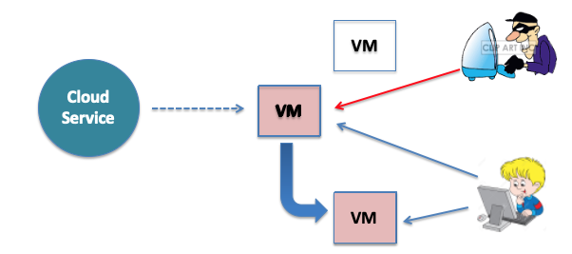
Moving Target Defense
Moving target defense (MTD) is the concept of controlling change across multiple systems by moving around VMs hosting services
MTD focuses on enabling safe operation in a compromised environment, rather than trying to create a perfectly secure environment
66

Slide 67
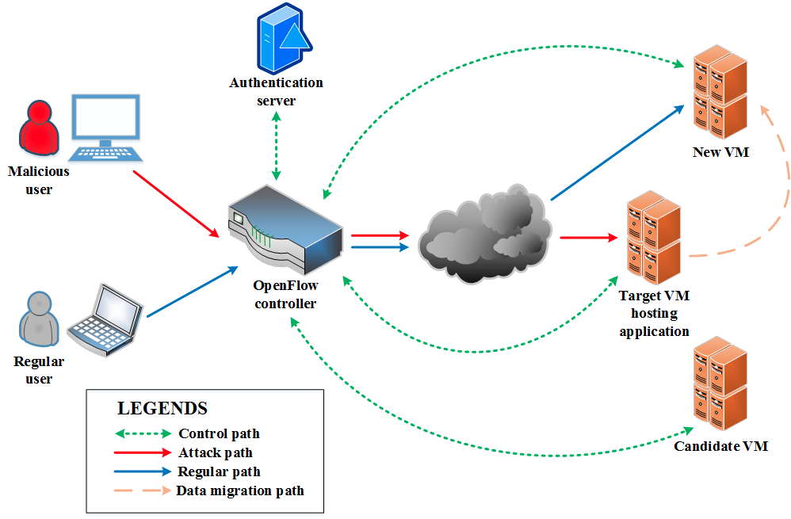
MTD System Model
Malicious and regular users accessing the services hosted by a target VM
Authentication server to direct users to entitled services in VMs
Open flow controller to detect attack, run MTD logic, and perform migration
Only regular users redirected to new VM
67

Slide 68
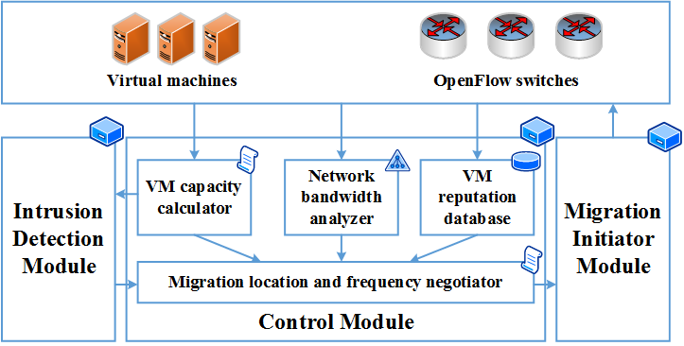
MTD Controller Architecture
68

Slide 69
Three Big Questions
Where to move?
Finding the optimal candidate VM to migrate
Identifying the most pertinent VM selection factors and their relative importance to create migration logic
Periodic/on-demand information collection
When to move?
Finding the optimal frequency of movement
Not too frequent as migration incurs cost, and not too seldom as increases probability of getting attacked
How to move?
Mostly pertains to implementation issues
Proactive/reactive migration execution
Runtime migration or file copy
Redirection of regular users
69

Slide 70
How to Defend Against DoS Attacks – On your own?
In addition to previously mentioned methods…
Configure your firewall to
Filter out incoming ICMP packets
Disallow any incoming traffic
Use tools such as NetStat and others
Disallow traffic not originating within the network
Disable all IP broadcasts
Filter for external and internal IP addresses
Keep AV signatures, OS, and software patches current
Have an Acceptable Use Policy

Slide 71
Summary
DoS attacks are among the most common attacks on the Internet
DoS attacks are unsophisticated
DoS attacks can have devastating effects
Your task is constant vigilance and protection strategy

Slide 72
TCP fundamental
Attacks on the TCP protocol
Denial-of-Service attack
SQL injection attack
Cross-side scripting attack
Miscellaneous: Heartbleed bug and attack, Ransomware, Cryptojacking
Module 2

Slide 73
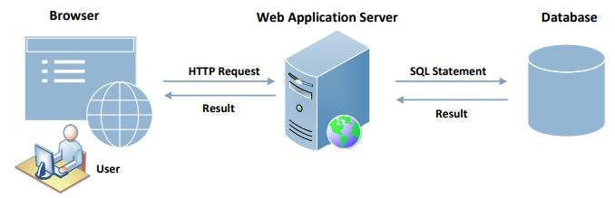
Interacting with Database in Web Application
A typical web application consists of three major components:
SQL (Structured Query Language) Injection attacks can cause damage to the database
As we notice in the figure, the users do not directly interact with the database but through a web server; If this channel is not implemented properly, malicious users can attack the database
73
Notes:
Explanation of the components:
Web Browser: Browser is on the client side, its primary function is to get content from the web server, present the content to the user, interact with the user and get the user inputs
Web Application server: They are responsible for generating and delivering content to the browser. They usually rely on an independent database server for data management
Browsers communicate with web servers using the Hypertext Transfer Protocol, while web servers interact with databases using database languages, such as SQL

Slide 74
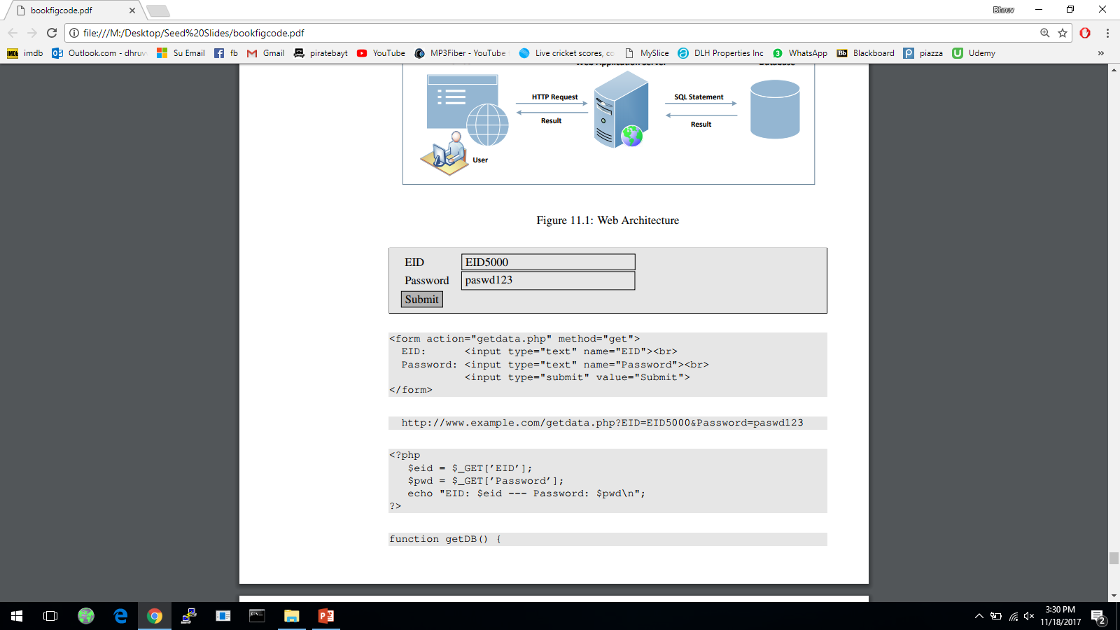

Getting Data from User
This example shows a form where users can type their data; Once the submit button is clicked, an HTTP request will be sent out with the data attached
The HTML source of the above form is given below:
Request generated is:
74
Notes:
Depending on whether the HTTP request is a GET or POST request, the ways how data are attached are different.

Slide 75

Getting Data from User
The request shown is an HTTP GET request, because the method field in the HTML code specified the get type
In GET requests, parameters are attached after the question mark in the URL
Each parameter has a name=value pair and are separated by “&”
In the case of HTTPS, the format would be similar but the data will be encrypted
Once this request reached the target PHP script the parameters inside the HTTP request will be saved to an array $_GET or $_POST; The following example shows a PHP script getting data from a GET request:
75

Slide 76
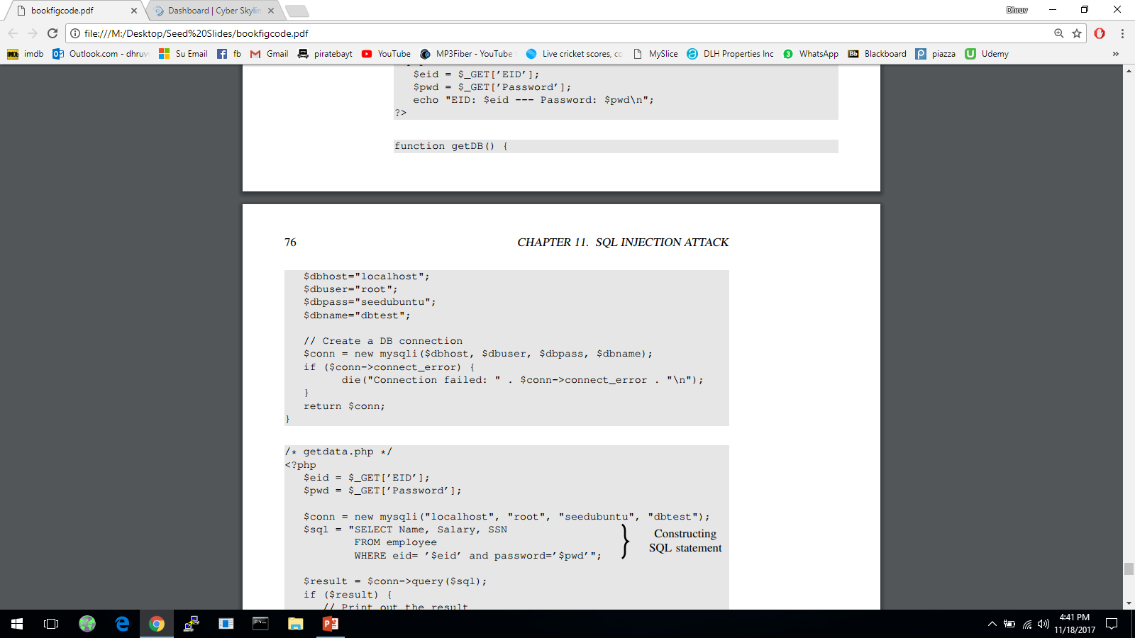
How Web Applications Interact with Database
Connecting to MySQL Database
PHP program connects to the database server before conducting query on database
Code shown below uses new mysqli(…) along with its 4 arguments to create the database connection
MySQLi extension allows PHP programs to access the functionality provided by MySQL 4.1 and above
76
Notes:
Web apps store data in databases and fetch additional data based on given input from database.
3 main methods for PHP programs to interact with a MySQL database:
PHP’s MySQL Extension
PHP’s MySQLi Extension [commonly used]
PHP Data Objects
MySQLi extension allows PHP programs to access the functionality provided by MySQL 4.1 and above.
4 arguments of mysqli: hostname of database server, login name, password and the database name.
The hostname depends on where the database is run. If on same machine as the web app server then we use “localhost”.

Slide 77
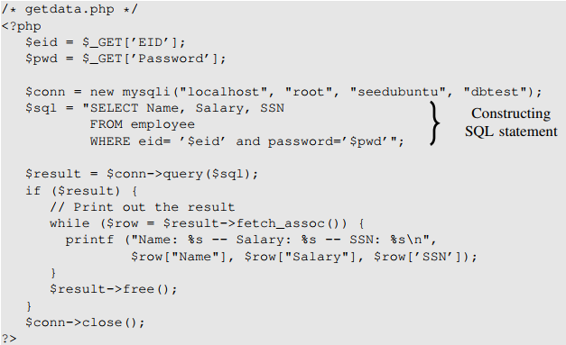
How Web Applications Interact with a Database?
Construct the query string and then send it to the database for execution
Data typed in form, eventually become part of the SQL string executed by database
The channel between user and database creates a new attack surface for the database – this channel needs protection
77
Notes:
Code shows how query string is constructed, executed, and how the queried results are obtained.
Data typed in form, eventually become part of the SQL string executed by database.
Even though user doesn’t directly interact with the database, there does exists a channel between the user and the database.
If not protected properly, user may be able to launch attacks on the database through channel.

Slide 78
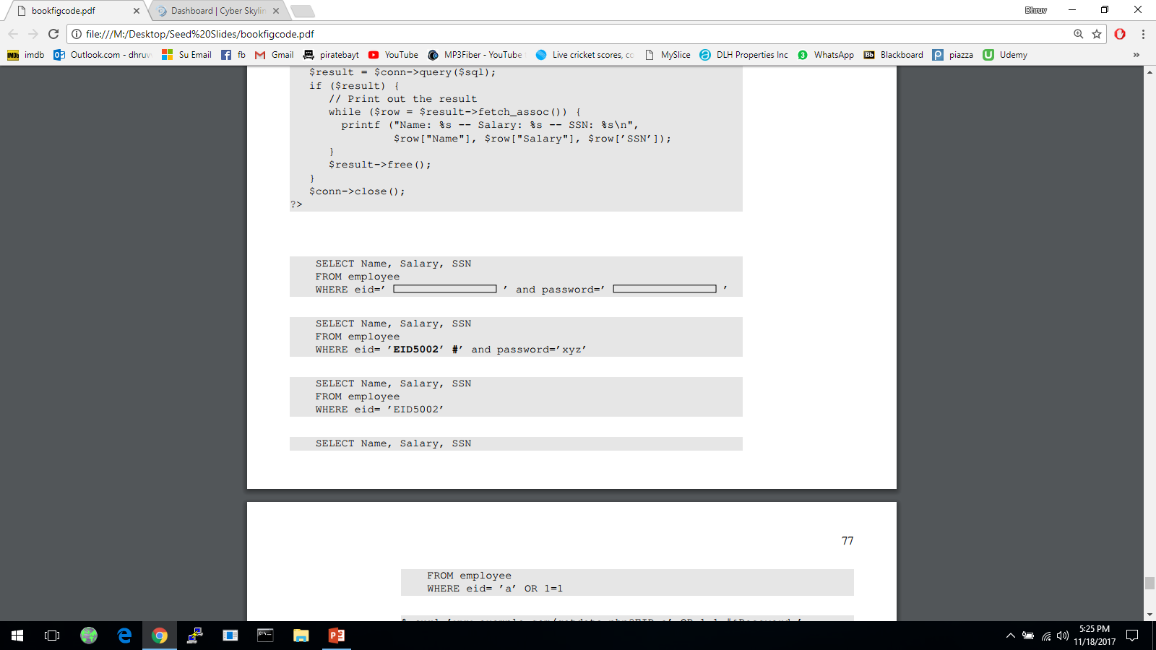
Launching SQL Injection Attacks
Everything provided by user will become part of the SQL statement (user data is mixed with web application code and given to the database); Is it possible for a user to change the meaning of the SQL statement?
The intention of the web app developer by the following is for the user to provide some data for the blank areas:
Assume that a user inputs a random string in the password entry and types “EID5002’#” in the eid entry; The SQL statement will become the following:
User is taking help of some special characters (e.g., # which will comment remainder of query i.e., the password check) to change the meaning of the SQL statement
78
Notes:
To understand possible attacks, we consider the abstract version of the web app creates a SQL statement template and a user needs to fill in the blanks inside the rectangle area.
The attack demonstrated shows the user taking help of some special characters to change the meaning of the SQL statement.

Slide 79

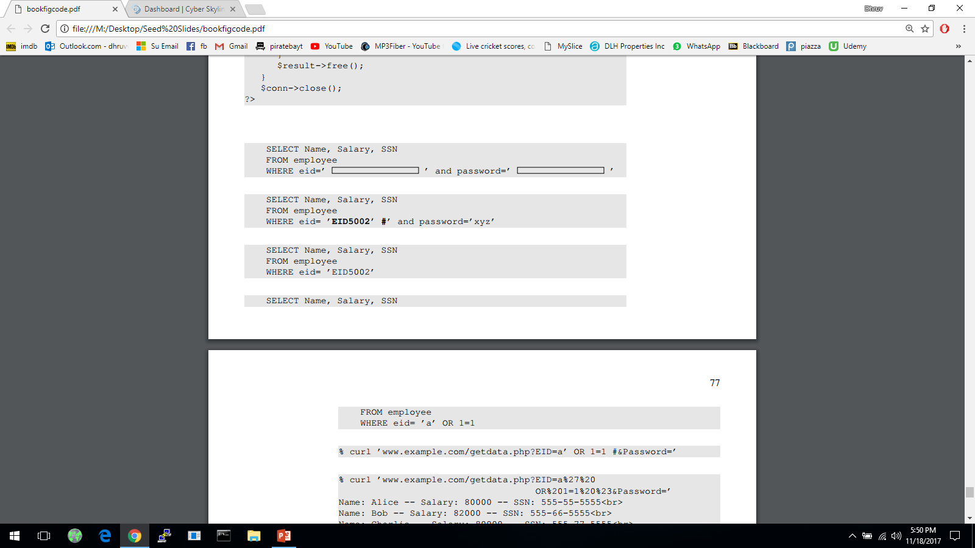
Launching SQL Injection Attacks
Everything from the # sign to the end of line is considered as comment; The SQL statement will be equivalent to the following:
The above statement will return the name, salary and SSN of the employee whose EID is EID5002 even though the user doesn’t know the employee’s password; This is a security breach
Let’s see if a user can get all the records from the database assuming that we don’t know all the EID’s in the database
We need to create a predicate for WHERE clause so that it is true for all records (i.e., ‘a’ is dummy that would not have any match, BUT we can add a true condition like “OR 1 =1” to match all the records)
79

Slide 80
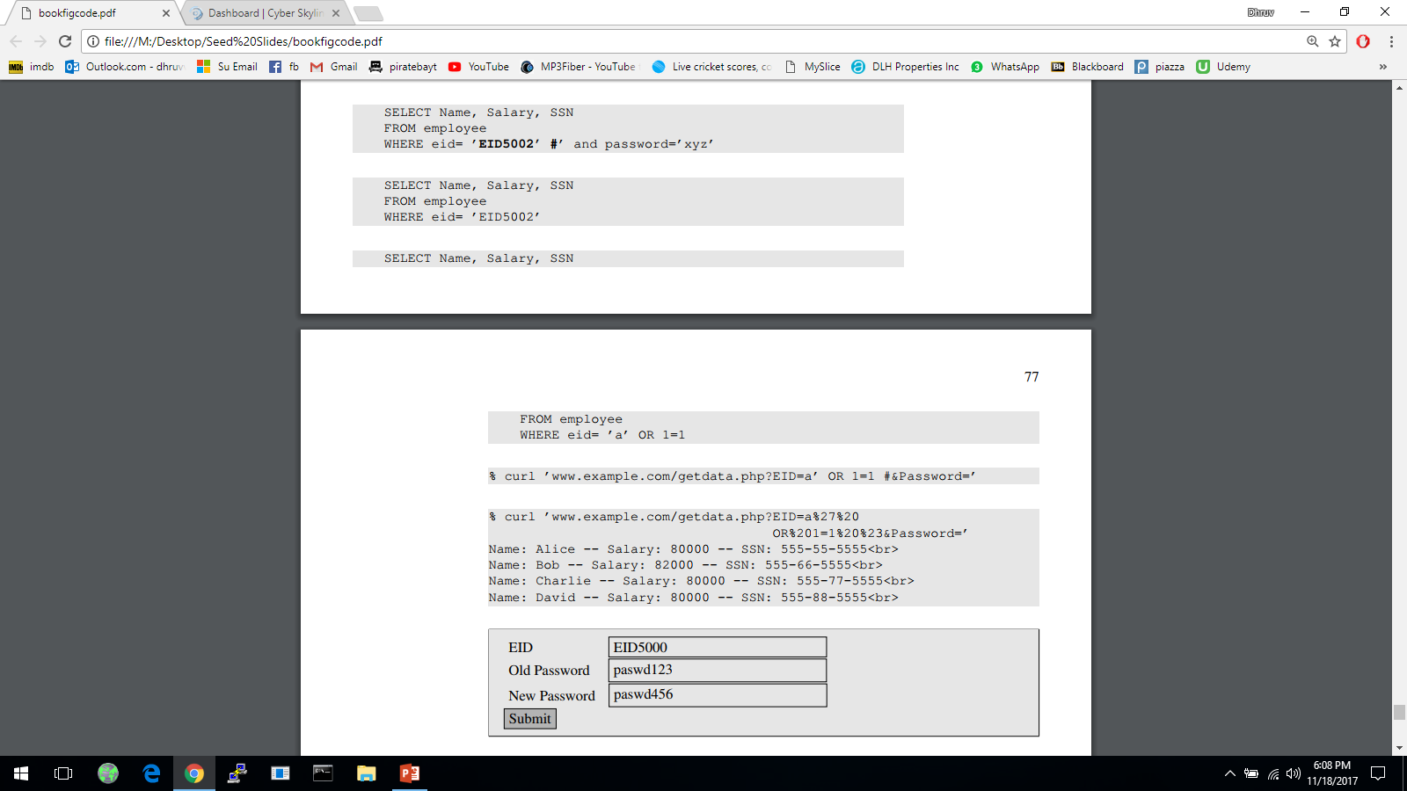

Launching SQL Injection Attacks using cURL
More convenient to use a command-line tool to launch attacks
Easier to automate attacks without a graphic user interface
Using cURL, we can send out a form from a command-line, instead of from a web page as follows:
The above command will not work; In an HTTP request, special characters are in the attached data needs to be encoded (with %20) or they maybe mis-interpreted
In the above URL we need to encode the apostrophe, whitespace and the # sign and the resulting cURL command is as shown below:
80
Notes:
In the previous section, we launch attacks using forms. Here we see how to perform those attacks using command-line tools.
cURL- widely used command-line tool for sending data over a number of network protocols, including HTTP and HTTPS.
URL syntax also uses some special characters so if the special characters attached to data is not encoded, it will be mis-interpreted.
Encoding for space is %20
Encoding for # is %23
Encoding for apostrophe is %27

Slide 81
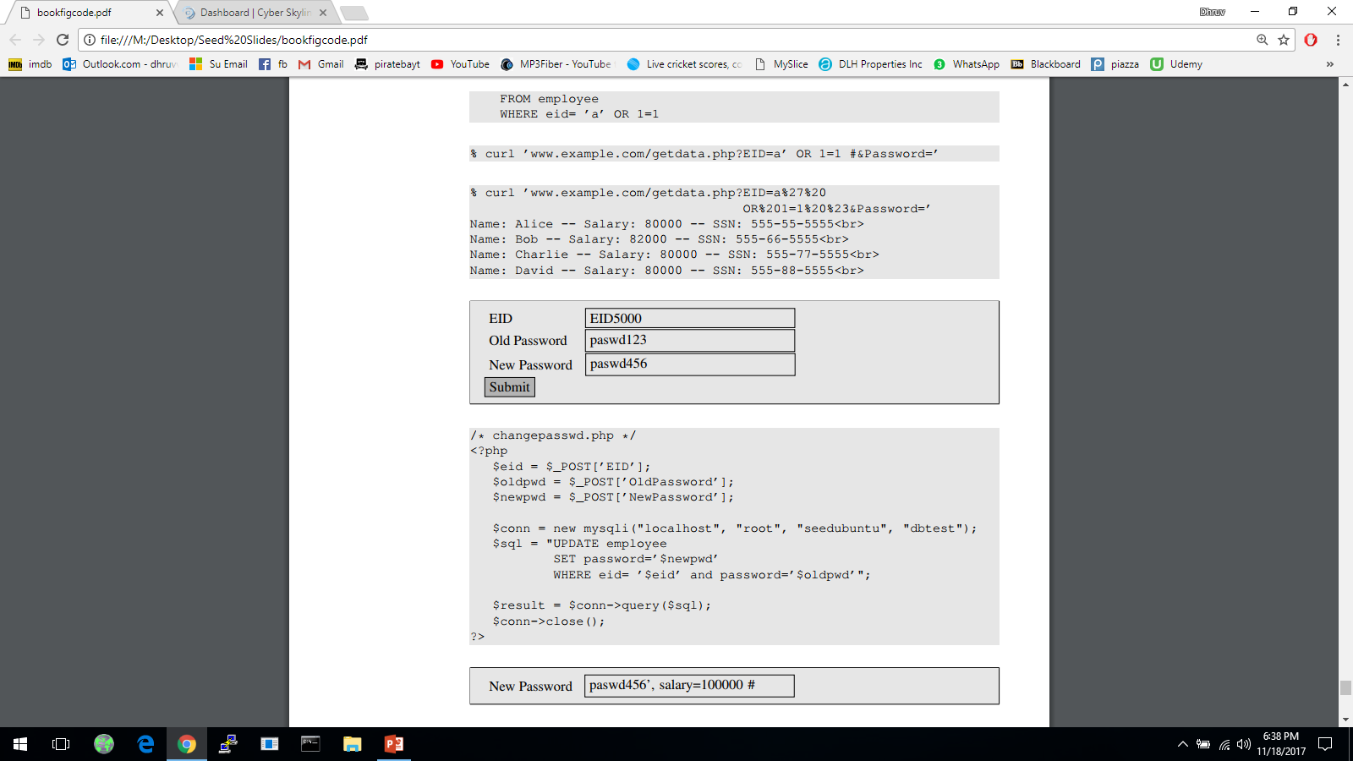
Modify Database
If the statement is UPDATE or INSERT INTO, we will have chance to change the database
Consider the form created for changing passwords; It asks users to fill in three pieces of information, EID, old password and new password
When Submit button is clicked, an HTTP POST request will be sent to the server-side script changepasswd.php, which uses an UPDATE statement to change the user’s password
81

Slide 82
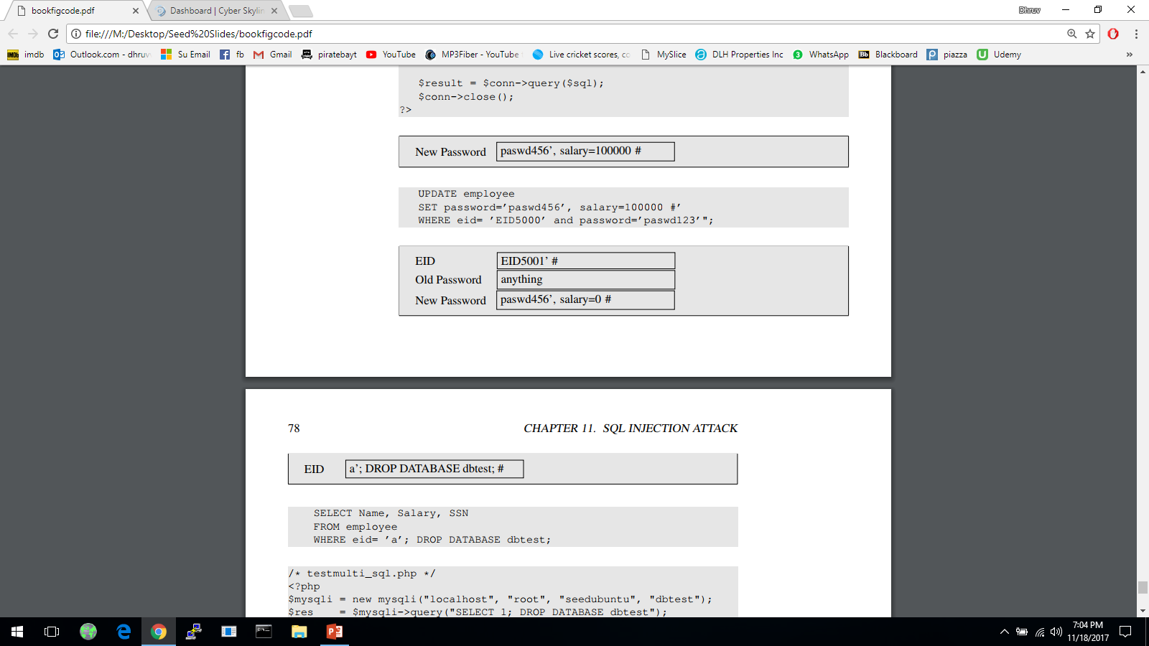


Modify Database
Due to SQL injection vulnerability, attackers can change other attributes (e.g., salary)
Let us assume that Alice (EID5000) is not satisfied with the salary she gets; She would like to increase her own salary using the SQL injection vulnerability; She would type her own EID and old password. The following will be typed into the “New Password” box:
By typing the above string in “New Password” box, we get the UPDATE statement to SET one more attribute for us, the salary attribute; The SQL statement will now look as follows:
What if Alice doesn’t like Bob and would like to reduce Bob’s salary to 0, but she only knows Bob’s EID (eid5001), not his password; How can she execute the attack?
82
Notes:
User inputs are used to construct the SQL statement, hence there is a SQL injection vulnerability.
A single UPDATE statement can set multiple attribute of a matching record, if a list of attributes, separated by commas, is given to the SET command.
The SQL statement in changepassword.php is meant to set only one attribute, the password attribute.
The intention of the PHP script is to change the password attribute. Due to SQL injection vulnerability, attackers can make changes to other attributes (here, salary).

Slide 83

Multiple SQL Statements
Damages that can be caused are bounded because we cannot change everything in the existing SQL statement
It will be more dangerous if we can cause the database to execute an arbitrary SQL statement
To append a new SQL statement “DROP DATABASE dbtest” to the existing SQL statement to delete the entire dbtest database, we can type the following in the EID box
The resulting SQL statement is equivalent to the following, where we have successfully appended a new SQL statement to the existing SQL statement string
The above attack doesn’t work against MySQL, because in PHP’s mysqli extension, the mysqli::query() API doesn’t allow multiple queries to run in the database server
83

Slide 84
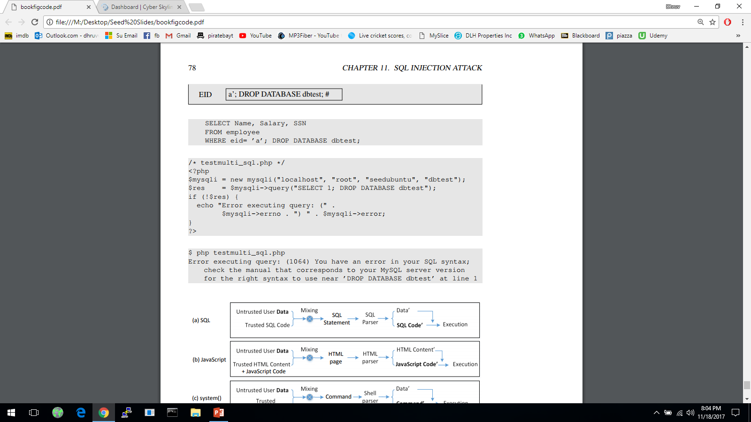
Multiple SQL Statements
The code below tries to execute two SQL statements using the $mysqli->query() API
When we run the code, we get the following error message:
If we do want to run multiple SQL statements, we can use $mysqli -> multi_query() [not recommended for security purposes]
84
Notes:
For the sake of security, we should avoid using the $mysqli->multi_query() API in codes, especially if the SQL statement string contains untrusted data.

Slide 85

SQL Injection Humor
85

Slide 86
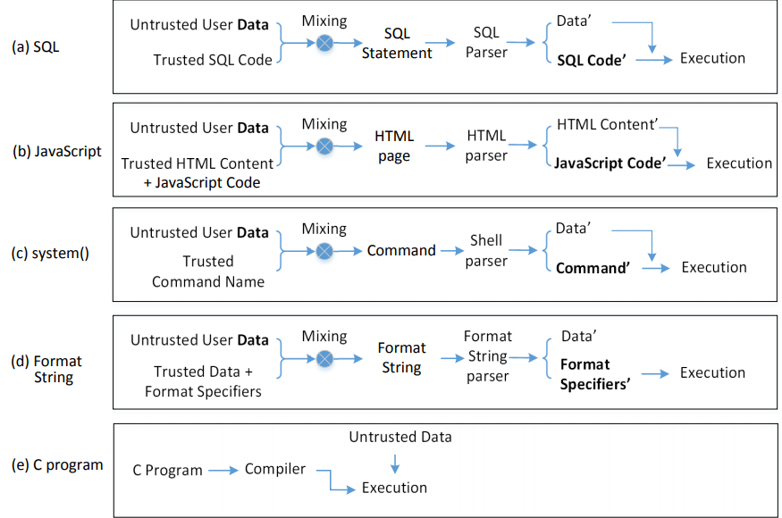
The Fundamental Cause
Mixing data and code together is the cause of several types of vulnerabilities and attacks including SQL Injection attack, XSS attack, attacks on the system() function and format string attacks
SQL Injection
Cross-Site Scripting
Shell Script Injection
86

Slide 87

Countermeasures: Filtering and Encoding Data
Before mixing user-provided data with code, inspect the data; Filter out any character that may be interpreted as code
Special characters are commonly used in SQL Injection attacks; To get rid of them, encode them
Encoding a special character tells parser to treat the encoded character as data and not as code; This can be seen in the following example
PHP’s mysqli extension has a built-in method called mysqli::real_escape_string(); It can be used to encode the characters that have special meanings in SQL
The following code snippet shows how to use this API
The filtering or escaping approach doesn’t address the fundamental cause of the problem; Data and code are still mixed together
87
Notes:
Characters that have special meaning in SQL statement and can be encoded, includes:
NULL (ASCII 0), carriage return (\r), newline (\n), backspace (\b), etc
The filtering or escaping approach doesn’t address the fundamental cause of the problem.
Data and code are still mixed together.
The approach makes code more secure.

Slide 88
Countermeasures: Prepared Statement
Fundament cause of SQL injection: mixing data and code
Fundament solution: separate data and code
Main Idea: Sending code and data in separate channels to the database server; This way the database server knows not to retrieve any code from the data channel
How: using prepared statement
Prepared Statement:
It is an optimized feature that provides improved performance if the same or similar SQL statement needs to be executed repeatedly
Using prepared statements, we send an SQL statement template to the database, with certain values called parameters left unspecified
The database parses, compiles and performs query optimization on the SQL statement template and stores the result without executing it; We later bind data to the prepared statement
88
Notes:
Countermeasure for attack on system(); use execve(). It takes the command name and data separately, using separate arguments.
Prepared statements not developed for security purpose but an ideal candidate for countermeasure against SQL injection attacks since it separates data and code.

Slide 89


Countermeasures: Prepared Statement
The vulnerable version: code and data are mixed together
Using prepared statements, we separate code and data
Send code
Send data
Start execution
89
Notes:
Lines 1 and 2 : Preparing SQL statement
Line 3 : Binding Data
Line 4, 5 and 6 : Execution and Retrieving results

Slide 90
Why Are Prepared Statements Secure?
Trusted code is sent via a code channel
Untrusted user-provided data is sent via data channel
Database clearly knows the boundary between code and data
Data received from the data channel is not parsed
Attacker can hide code in data, but the code will never be treated as code, so it will never be attacked
90

Slide 91
TCP fundamental
Attacks on the TCP protocol
Denial-of-Service attack
SQL injection attack
Cross-side scripting attack
Miscellaneous: Heartbleed bug and attack, Ransomware, Cryptojacking
Module 2

Slide 92
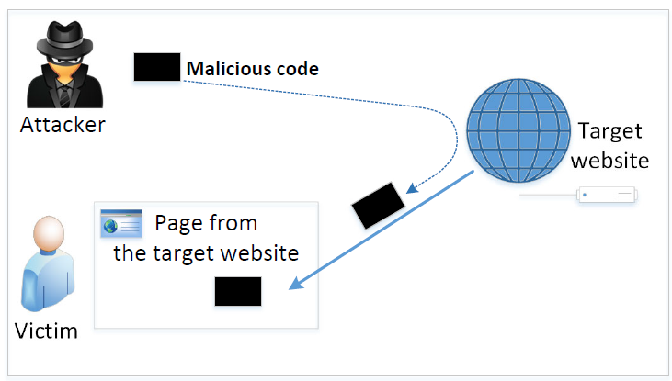
The Cross-Site Scripting Attack
In XSS, an attacker injects malicious code to the victim’s browser via the target website
When code comes from a website, it is considered as trusted with respect to the website, so it can access and change the content on the pages, read cookies belonging to the website and sending out requests on behalf of the user
Basically, code can do whatever the user can do inside the session
Types:
Non-persistent (Reflected) XSS Attack
Persistent (Stored) XSS Attack
92

Slide 93

Samy Computer Worm
Samy is a cross-site scripting worm that was designed to propagate across the social networking site MySpace by Samy Kamkar
Within just 20 hours of its October 4, 2005 release, over one million users had run the payload making Samy the fastest-spreading virus of all time
93
Notes:
Samy is put on friend list and then put a statement in your profile “Samy is my hero”. If attacked, you carry his code and then others who visit carry the code further – so quickly spreads
Lab uses a social network site that has a container – Elgg with countermeasures commented out [Target: seed-server.com]

Slide 94
Clinton-Obama Campaigns XSS Attack
Finnish security researcher Harry Sintonen published an example of a cross-site scripting vulnerability on votehillary.org
Sintonen's example submits a POST request to the Vote Hillary website and injects an iframe, causing the site to display the contents of Barack Obama's website
94

Slide 95
BBC XSS Attack
A cyber-attack on Twitter platform Tweetdeck infiltrated several accounts, and re-tweeted garbled code
The BBC's main Twitter account fell foul of the attack, re-tweeting incomprehensible code
95

Slide 96
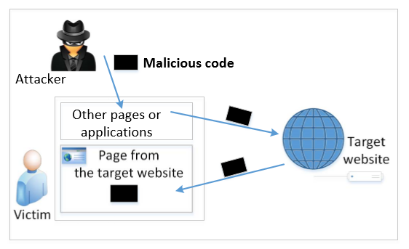
Non-persistent (Reflected) XSS Attack
Many websites take input from the user, conduct some activities and then send response to the user in a web page, with the original user input included on the response (i.e., the user input is reflected back)
E.g., Google search will give back your input and results
If a website with a reflective behaviour takes user inputs, then:
Attackers can put JavaScript code in the input, so when the input is reflected back, the JavaScript code will be injected into the web page from the website
96
Notes:
Attacker could put malicious code in Disk in old days, now with web – we use a website to inject the code
Many websites take input from the user, conduct some activities and then send response to the user in a web page, with the original user input included on the response (i.e the user input is reflected back)
“Convenience is the enemy of security” – HTML mixes data and code

Slide 97
Non-persistent (Reflected) XSS Attack
Assume a vulnerable service on website : http://www.example.com/search?input=word, where word is provided by the users
Now the attacker sends the following URL to the victim and tricks him to click the link: http://www.example.com/search?input=<script>alert(“attack”);</script>
Once the victim clicks on this link, an HTTP GET request will be sent to the www.example.com web server, which returns a page containing the search result, with the original input in the page
The input here is a JavaScript code which runs and gives a pop-up message on the victim’s browser
97

Slide 98
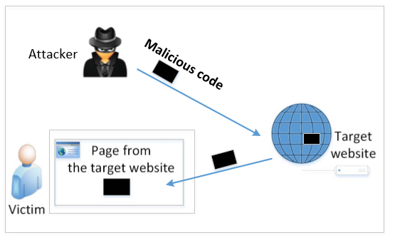
Persistent (Stored) XSS Attack
Attackers directly send their data to a target website/server which stores the data in a persistent storage
If the website later sends the stored data to other users, it creates a channel between the users and the attackers
Example: User profile in a social network is a channel as it is set by one user and viewed by another
98
Notes:
Same with Clinton/Obama site and the Samy Worm case i.e., they were persistent XSS attacks

Slide 99
Persistent (Stored) XSS Attack
These channels are supposed to be data channels
But data provided by users can contain HTML markups and JavaScript code
If the input is not sanitized properly by the website, it is sent to other users’ browsers through the channel and gets executed by the browsers
Browsers consider it like any other code coming from the website; Therefore, the code is given the same privileges as that from the website
99
Notes:
Session ID (SID) – we need to steal it, we send code to your computer through the social network platform that exchanges information flows; code steals your SID and attacker abuses

Slide 100

Damage Caused by XSS
Web defacing: JavaScript code can use DOM (Document Object Model) APIs to access the DOM nodes inside the hosting page; Therefore, the injected JavaScript code can make arbitrary changes to the page
Example: JavaScript code can change a news article page to something fake or change some pictures on the page
100
Notes:
Browser parses the DOM tree

Slide 101
Damage Caused by XSS
Spoofing requests: The injected JavaScript code can send HTTP requests to the server on behalf of the user
Stealing information: The injected JavaScript code can also steal victim’s private data including the session cookies, personal data displayed on the web page, data stored locally by the web application
101

Slide 102
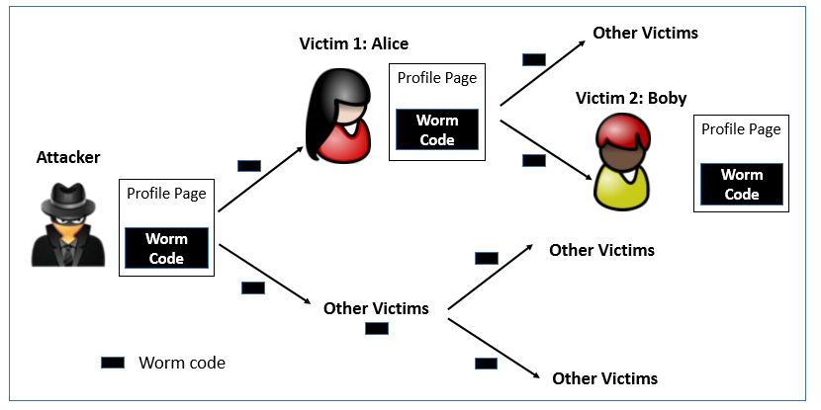
Self-Propagation XSS Worm
When an infected profile is viewed by others, the code can further spread – victim is turned into an attacker via a link approach or DOM approach
To become a real worm, the malicious JavaScript program should be able to propagate itself, i.e. self-propagating cross-site scripting worm
102
Notes:
How to copy code? Russia doll but we don’t want smaller size; Two approaches: By yourself or Through External help
Attack has a link to external file with attack code e.g., to modify the page ‘samy is my hero’ and links this external file from inside the page

Slide 103
Countermeasures: The Filter Approach
Removes code from user inputs (corrects the mistake of mixing code and data together)
It is difficult to implement as there are many ways to embed code other than <script> tag
Use of open-source libraries that can filter out JavaScript code
Example: jsoup
103

Slide 104
Countermeasures: The Encoding Approach
Replaces HTML markups with alternate representations
If data containing JavaScript code is encoded before being sent to the browsers, the embedded JavaScript code will be displayed by browsers, not executed by them
Converts <script> alert(‘XSS’) </script> to &lt;script&gt;alert(‘XSS’)
104

Slide 105
Countermeasures: Using CSP
How websites tell browsers which code source is trustworthy is achieved using a security mechanism called Content Security Policy (CSP)
This mechanism is specifically designed to defeat XSS and ClickJacking attacks
CSP has become a standard, which is supported by most browsers nowadays
CSP not only restricts JavaScript code, it also restricts:
other page contents, such as limiting where pictures, audio, and video can come from
whether a page can be put inside an iframe or not (used for defeating ClickJacking attacks)
105

Slide 106
In-Class Practices
Question 1: In order to implement the classic DoS flood attack, the attacker must generate a sufficiently large volume of packets to exceed the capacity of the link to the target organization. Consider an attack using ICMP echo request (ping) packets that are 500 bytes in size (ignoring framing overhead). How many of these packets per second must the attacker send to flood a target organization using a 0.5-Mbps link? How many per second if the attacker uses a 2-Mbps link? Or a10-Mbps link?

Slide 107
Answers to Q1
Let’s have the following parameters: w the bandwidth of the communications channel, and p the minimum number of 500-byte size packets needed to exceed the capacity of the channel. To reach the capacity of the channel (p * 500 * 8) = w, with w expressed in bits, so p = w/4000. Based on it for each case we have:
w = 0.5 Mbps = 500,000 bits; p = 500000/4000 = 125 packets/second
w = 2.0 Mbps = 2,000,000 bits; p = 2000000/4000 = 500 packets/second
w = 10.0 Mbps = 10,000,000 bits; p = 10000000/4000 = 2,500 packets/second

Slide 108
In-Class Practice
Question 2: Consider a distributed variant of the attack we explore in Problem Q1. Assume the attacker has compromised a number of broadband-connected residential PCs to use as zombie systems. Also assume each such system has an average uplink capacity of 128 kbps. What is the maximum number of 500-byte ICMP echo request (ping) packets a single zombie PC can send per second? How many such zombie systems would the attacker need to flood a target organization using a 0.5-Mbps link? A 2-Mbps link? Or a10-Mbps link? Given reports of botnets composed of many thousands of zombie systems, what can you conclude about their controller’s ability to launch DDoS attacks on multiple such organizations simultaneously? Or on a major organization with multiple, much larger network links than we have considered in these problems?

Slide 109
Answers to Q2
Let’s have the following parameters: w the bandwidth of the communications channel, and p the minimum number of 500-byte size packets needed to exceed the capacity of the channel, and z the number of zombies needed to exceed the capacity of the channel. The maximum number of packets a zombie can send is p_{z} = 128,000/4000 =32 pps (packets per second). Based on the results from Q2, the number of required zombies will be z = p/p_{z} = p/32, and for each case we have:
w = 0.5 Mbps; z = 125pps/32pps = 3,9 (requires 4 zombies)
w = 2.0 Mbps; z = 500pps/32pps = 15,6 (requires 16 zombies)
w = 10.0 Mbps; z = 2500pps/32pps = 78,1 (requires 79 zombies)
Based on the results we got above, it suggests that just a few zombies with relatively low capacity communication channel will be able to cause problems to organizations. In the examples above, with corporate bandwidth from 0.5Mbps to 10Mbps, we have a very narrow channel for today’s standards, however the number of zombies required to shut those networks down is small compared with the thousands of zombies that a botnet controller could use. With thousands of zombies conducting flooding DoS attacks, a botnet controller will be able to attack many organizations at the same time or a big organization with multiple links. If the botnet controller manages to increase the size of the packet the attack will be even more effective.

Slide 110
In-Class Practices
Question 3: All the information that a server needs to know about a connection is not only contained in the SYN packet, but also in the final ACK packet from the client. Therefore, information-wise, there is no need to allocate a buffer to save the information about half-open connections. If we get rid of this buffer, the SYN flooding attack will not be effective any more. Do you agree with such a statement or not. Please justify your answer.

Slide 111
Answers to Q3
Basically, if we get rid of the buffer, we have solved the SYN flooding attack problem, but we will introduce a new and more powerful attack. The attacker can simply send ACK flooding packets, each one causing the server to allocate memory for a full connection, which takes more memory than that for half-open connections.

Slide 112
TCP fundamental
Attacks on the TCP protocol
Denial-of-Service attack
SQL injection attack
Cross-side scripting attack
Miscellaneous: Heartbleed bug and attack, Ransomware, Cryptojacking
Module 2

Slide 113

The Heartbleed Bug and Attack
Vulnerability in the OpenSSL library, specifically the Heartbeat protocol in TLS (Transport Layer Security)
OpenSSL (widely used library for TLS) drives HTTPS that your web browser relies on for online banking, and other secure transactions
Launched in 2012 on web servers built on top of OpenSSL
Disclosed in 2014
113
Notes:
OpenSSL is a commercial grade toolkit for the TLS/SSL protocols
Many secure web servers are built on top of OpenSSL.
When a client and server are not sending data to each other for a period of time, either side or firewall in between may break the channel.
The protocol:
The sender send a Heartbeat packet to receiver.
Inside the packet there is payload, payload length field. (Actual content of payload is not important)
The receiver constructs a response packet and should carry same payload data as in request.
When the receiver gets a heartbeat request, it retrieves payload length value (n) from the packet, copies n bytes of data to the response packet, starting from the beginning of the payload field in the request packet.

Slide 114
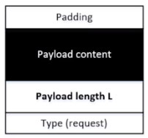
Background: the Heartbeat Protocol
TLS/SSL protocols provide a secure channel between two communicating applications
Heartbeat extension: implement keep-alive feature of TLS
Maintains secure session without interruption (e.g., from firewall) when client and server are not sending data to each other for a period of time
Hard to initiate and re-establish secure sessions
Send request packet to receiver and obtain an acknowledgement packet by doing a copy of the payload content based on payload length L
The copy caused the vulnerability; attacker can specify larger L
Heartbleed bug is an implementation flaw in TLS/SSL heartbeat extension
114
Notes:
OpenSSL is a commercial grade toolkit for the TLS/SSL protocols
Many secure web servers are built on top of OpenSSL.
When a client and server are not sending data to each other for a period of time, either side or firewall in between may break the channel.
The protocol:
The sender send a Heartbeat packet to receiver.
Inside the packet there is payload, payload length field. (Actual content of payload is not important)
The receiver constructs a response packet and should carry same payload data as in request.
When the receiver gets a heartbeat request, it retrieves payload length value (n) from the packet, copies n bytes of data to the response packet, starting from the beginning of the payload field in the request packet.

Slide 115
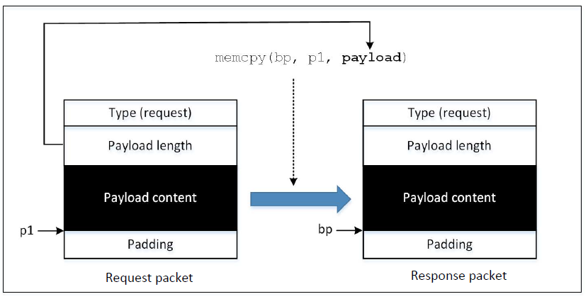
How Response Packet is Constructed
Problem: how much is copied depends on the value contained in the payload length field
What if this value is larger than the actual payload size?
115

Slide 116
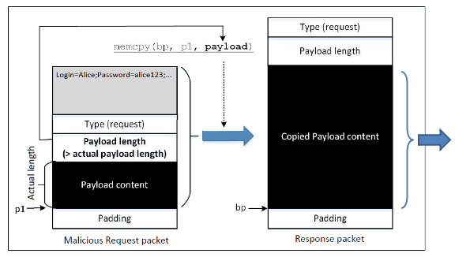
Attack Launch
Attack Results: Some data from the server’s memory also got copied into the response packet, which will be sent out
116
Notes:
To launch a Heartbleed attack, an attacked sends a specially crafted Heartbeat request packet to the victim
Inside this packet, the number put in the payload size field is larger than the actual payload size
When the packet arrives on receiver side, memcpy() will copy more data into the response packet than the request packet.
The affected memory may store sensitive information, such as passwords, credit card info or other user information.
This data will be copied into the response packet and sent to the attacker
By sending a heartbeat request to a vulnerable remote server, attackers can dump the server’s memory and steal sensitive information.

Slide 117
Attack Launch
To launch a Heartbleed attack, an attacked sends a specially crafted Heartbeat request packet to the victim
Inside this packet, the number put in the payload size field is larger than the actual payload size
When the packet arrives on receiver side, memcpy() will copy more data into the response packet than the request packet (i.e., receiver does a memory dump)
The affected memory may store sensitive information, such as passwords, credit card info or other user information
This data will be copied into the response packet and sent to the attacker
By sending a heartbeat request to a vulnerable remote server, attackers can dump the server’s memory and steal sensitive information
117

Slide 118
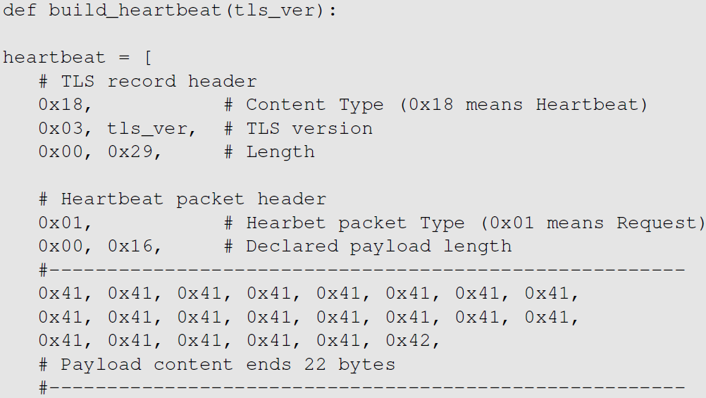
Launch the Heartbleed Attack
0x0016 (22 bytes) is placed in the length field, which exactly matches with the actual length of the payload
We play with this length field to perform our attack in the next slide
From the code snippet we can see that:
TLS record’s size = 0x0029 (not including the record header), which is the size of the payload in the TLS record
The payload contains a Heartbeat request packet, and has its own header (3 bytes) payload (22 bytes) and paddings (16 bytes)
The value 0x0016 is the value that exactly matches with the actual payload (22 bytes), so we will not be able to get any additional data from the server
118
Notes:
Code originally written by Jared Stafforf [Staffoed, 2014].
The attack code constructs a Heartbeat request packet after having established a TLS connection with the target server.
From the code snippet we can see that:
TLS record’s size = 0x0029 (not including the record header), which is the size of the payload in the TLS record.
The payoad contains a Heartbeat request packet, and has its own header (3 bytes) payload (22 bytes) and paddings (16 bytes).
The value 0x0016 is the value that exactly matches with the actual payload, so we will not be able to get any additional data from the server.

Slide 119

Launch the Heartbleed Attack
We got some secret from the server
We increase this value to higher values (e.g. 0x4000 i.e., 16K; much larger than the actual payload size -> 22 bytes) and start getting larger packets back
The attack.py program prints out the payload data in the response packet
If no user has logged into the server yet before the attack, there will not be much useful data stored in memory
When running the attack multiple times, we may get back different data, because each request packet might be stored at a different memory address
119
Notes:
We increase this value to higher values (e.g. 0x4000 i.e., 16K; much larger than the actual payload size -> 22 bytes) and start getting larger packets back.
The attack.py program prints out the payload data in the response packet.
Analyzing the result:
We find some data return from server like password seedadmin for admin. The admin user has logged into the webserver. Hence, the username and password are still in the memory.
When server constructs the Heartbeat response packet, due to the attack, the server end up sending a lot of data from its memory to the attacker.
If no user has logged into the server yet before the attack, there will not be much useful data stored in memory.
When running the attack multiple times, we may get back different data, because each request packet might be stored at a different memory address.

Slide 120


Fixing the Heartbleed Bug
Simply update your system’s OpenSSL library. The following two commands can be used for it:
The following code shows how the OpenSSL library is fixed
120
Notes:
Comparing the shown code with the vulnerable version shown earlier,
An if statement is added
s -> s3 -> rrec.length is the total number of bytes in the request packet; this is the actual length and not the one declared in the request packet.
Constant 1 -> size of type field
Constant 2 -> size of length field
Constant 16 -> minimum padding length
The if statement compares whether the declared payload length plus a constant (19) is larger than the actual size of the request packet.
If larger, the packet is discarded and there will be no reply.
If attacker send a request packet with larger declared length value, the packet won’t have any effect.

Slide 121
Fixing the Heartbleed Bug – Use Bounds Checking
Comparing the shown code with the vulnerable version shown earlier,
An if statement is added
s → s3 → rrec.length is the total number of bytes in the request packet; this is the actual length and not the one declared in the request packet
Constant 1 → size of type field
Constant 2 → size of length field
Constant 16 → minimum padding length
The if statement compares whether the declared payload length plus a constant (19) is larger than the actual size of the request packet
If larger, the packet is discarded and there will be no reply
If attacker send a request packet with larger declared length value, the packet won’t have any effect
Story: Bounds Checking and Game Design
121
Notes:
Comparing the shown code with the vulnerable version shown earlier,
An if statement is added
s -> s3 -> rrec.length is the total number of bytes in the request packet; this is the actual length and not the one declared in the request packet.
Constant 1 -> size of type field
Constant 2 -> size of length field
Constant 16 -> minimum padding length
The if statement compares whether the declared payload length plus a constant (19) is larger than the actual size of the request packet.
If larger, the packet is discarded and there will be no reply.
If attacker send a request packet with larger declared length value, the packet won’t have any effect.

Slide 122
Cryptojacking
Cryptojacking is the unauthorized use (i.e., hijacking) of someone else’s computer processing power to mine cryptocurrency
Hackers do this by either:
Social Engineering / Malware: Getting the victim to click on a malicious link (phishing) in an email that loads cryptomining code (malware) on the computer, or
Browser-based Attacks: By infecting a website or online ad with JavaScript code that auto-executes once loaded in the victim’s browser (mining will take place as long as browser/tab is open)
Either way, the cryptomining code then works in the background as unsuspecting victims use their computers normally
Symptoms: overheating of device, high processor usage, slower performance or lags in execution
122

Slide 123




Latest Cryptojacking News
https://news.bitcoin.com/cryptojacking-a-rising-threat-to-all-internet-users
Hackers are increasingly turning to cryptojacking because it’s low-risk, low-investment, and an easy way to get steady and large profits…
Unlike other types of malware, like ransomware, where there is no guarantee the fraudsters will get paid, cryptojacking ensures they will make money without calling too much attention…
The crypto price surge is usually accompanied by a wave of cryptojacking attacks according to research published by cybersecurity firm Symantec…
Cryptojacking had previously been in a steep decline from March 2019 due to the shutdown of the mining script maker, CoinHive
In January 2018, researchers discovered the Smominru cryptomining botnet, which infected more than a half-million machines, mostly in Russia, India, and Taiwan (extracted ~$3.6 million in value within a month)
https://cointelegraph.com/news/browser-based-cryptojacking-is-back-as-attacks-spike-163
123
Notes:
In January 2018, researchers discovered the Smominru cryptomining botnet, which infected more than a half-million machines, mostly in Russia, India, and Taiwan. The botnet targeted Windows servers to mine Monero, and cybersecurity firm Proofpoint estimated that it had generated as much as $3.6 million in value as of the end of January

Slide 124

How Cryptojacking Works
Hackers inject a cryptomining script on a website or in an Ad that is placed on multiple sites
When the victim visits the infected website, or if the malicious Ad pops up in the victim’s browser, the script automatically executes
No code is stored on the victim’s computer and no damage is done to computers or victims’ data
Interaction with mining pool
124
Notes:
C&C server : Command and Control server: a computer controlled by an attacker or cybercriminal which is used to send commands to systems compromised by malware and receive stolen data from a target network.

Slide 125
Prevention of Cryptojacking
Use VPN to encrypt internet connections and hide IP address
Awareness and Training to thwart social engineering scams
Install an Ad-blocking or anti-cryptomining extension on web browsers
Use end-point protection that is capable of detecting known crypto miners
Keep your web filtering tools up to date
Maintain browser extensions
Use a mobile device management (MDM) solution to better control what’s on users’ devices
125

Slide 126
DNS and Attacks
DNS Hierarchy, Zones, and Servers
DNS Query Process
DNS Attacks: Overview
Local DNS Cache Poisoning Attack
Defense against DNS spoofing attacks
126

Slide 127

DNS Domain Hierarchy
Domain Name System (DNS) is a phonebook of the Internet – enables mapping of domain names to IP addresses of machines
Domain (nameserver) namespace is organized in a hierarchical tree-like structure
Each node is called a domain, or subdomain.
The root of the domain is called ROOT, denoted as ‘ . ‘
Internet Assigned Name Authority (IANA)
Below ROOT, we have Top-Level Domain (TLD). Ex: In www.example.com, the TLD is .com
The next level of domain hierarchy is second-level domain which are usually assigned to specific entities such as companies, schools etc.
127

Slide 128

DNS Zone
DNS is organized according to zones
A zone groups contiguous domains and subdomains on the domain tree and assign management authority to an entity
usa.example.com is a domain with subdomains as boston, nyc and chicago; Two zones are created for usa.example.com - First contains usa domain, chicago and boston subdomain and second contains nyc subdomain
Hierarchy tree structure depicts subdomains within example.com domain
In this case, there are multiple DNS zones one for each country; the zone keeps records of who the management authority is for each of its subdomains
For scalability, you have sub-domains on different name servers
128
Notes:
1 zone – if one domain on one nameserver; but in many situations if domain is big and you don’t want to host all on one name server, you can have sub-domains on different name servers – then you have different zones with subsets of sub-domains on different nameservers

Slide 129
Zone vs Domain
A DNS zone only contains a portion of the DNS data for a domain
If a domain is not divided into subdomains, the zone and domain are essentially the same, because the zone contains all the DNS data for the domain
When a domain is big, it is divided into subdomains
Their DNS data can still be put in the same zone, so domain and zone are still the same
But subdomains can have their own zones
129

Slide 130
Authoritative Name Servers
Each DNS zone has at least one authoritative nameserver that publishes information about the zone
It provides the original and definitive answers to DNS queries
An authoritative name server can be a master server (primary) or slave server (secondary)
A master server stores the master copies of all zone records whereas a slave server uses an automatic updating mechanism to maintain an identical copy of the master records
130

Slide 131

DNS ROOT Servers
The root zone is called ROOT
There are 13 authoritative nameservers (DNS root servers) for this zone
They provide the nameserver information about all top-level domains (TLDs)
https://www.internic.net/domain/root.zone
They are the starting point of DNS queries
131

Slide 132

13 DNS Root Servers
They are the most critical infrastructure on the Internet (they mirror the information by having multiple computers at different places in the world – accessible via anycast)
If you can bring down Root servers, the Internet will be down!
132

Slide 133
Top Level Domain (TLD)
Infrastructure TLD: .arpa
Generic TLD (gTLD): .com, .net,
Sponsored TLD (sTLD): These domains are proposed and sponsored by private agencies or organizations that establish and enforce rules restricting the eligibility to use the TLD: .edu, .gov, .mil, .travel, .jobs
Country Code TLD (ccTLD): .au (Australia), .cn (China), .fr (France)
Reserved TLD: .example, .test, .localhost, .invalid
133

Slide 134

DNS Query Process
DNS Cache
.com
Local DNS Files
Recursive
134
Notes:
DNS query is recursive – keep asking till you find the answer; Let’s ask example.com – talk to com server who has registered the nameserver for the example.com; if you ask that nameserver, if big – then it tell you which sub-domain

Slide 135

Local DNS Files
/etc/host: stores IP addresses for some hostnames. Before machine contacts the local DNS servers, it first looks into this file for the IP address.
/etc/resolv.conf: provide information to the machine’s DNS resolver about the IP address of the local DNS server. The IP address of the local DNS server provided by DHCP is also stored here.
135
Notes:
Dynamic Host Configuration Protocol

Slide 136

Local DNS Server and Iterative Query Process
The iterative process starts from the ROOT Server
If it doesn’t know the IP address, it sends back the IP address of the nameservers of the next level server (.NET server) and then the last level server (example.net) which provides the answer
136
Notes:
The Local DNS servers need not be local. They may or may not be set up in the local network. Google Public DNS is a DNS service offered by Google, serving any host on the Internet.

Slide 137

Emulating Local DNS Server (Step 1: Ask ROOT)
Directly send the query to one of the 13 root servers
No answer (the root does not know the answer)
Go ask them!
137
Notes:
If answer section exists, then you have the answer right away – if not go ask them (authority section)

Slide 138


Steps 2-3: Ask .net & example.net servers
Ask a .net nameservers.
Go ask them!
Ask an example.net nameservers.
Finally got the answer
138

Slide 139

DNS cache
When the local DNS server gets information from other DNS servers, it caches the information
Each piece of information in the cache has a time-to-live value, so it will be eventually time out and removed from the cache
Question: How local DNS server get’s root server IP?
Answer: The Zone file
139

Slide 140
DNS Attacks
Denial-of-Service Attacks (DoS): When the local DNS servers and the authoritative nameservers do not respond to the DNS queries, the machines cannot retrieve IP addresses which essentially cuts down the communication
DNS Spoofing Attacks:
Primary goal: provide a fraudulent IP address to victims, tricking them to communicate with a machine that is different from their intention
Example: If a user’s intention is to visit a bank’s web site to do online banking, but the IP address obtained through the DNS process is attacker’s machine, the user machine will communicate to the attacker’s web server
140

Slide 141

Overview of the Attack Surfaces
DNS queries involve several packets and thus present a broad attack surface in terms of spoofing (1 – 4 in figure below)
/etc/hosts file
with localhost information
You can also launch DoS attack at all points – root, local DNS server, TLD server
141

Slide 142
DNS Attacks on Compromised Machines
If attackers have gained the root privileges on a machine,
Modify /etc/resolv.conf: use malicious DNS server as the machine’s local DNS server and can control the entire DNS process
Modify /etc/hosts: add new records to the file, providing the IP addresses for some selected domains
For example, attackers can modify IP address of www.bank32.com which can lead to attacker’s machine
142

Slide 143

Spoofing DNS Replies (from LAN)
Attacks on user machines : When the user machine sends out a DNS query to its local DNS server, attacker can immediately send a spoofed reply, using local DNS as its source IP address; Attackers can put any arbitrary IP address in the reply
Attacks on local DNS server : Cache Poisoning attack : When the local DNS server sends out iterative queries to get an answer from the DNS servers on the Internet, attackers can send out spoofed replies to the local DNS server; They get accepted as long as they arrive before the actual replies - This is called DNS cache poisoning
143
Notes:
Attacks on user machines : When the user machine sends out a DNS query to its local DNS server, attacker can immediately send a spoofed reply, using local DNS as its source IP address. Attackers can put any arbitrary IP address in the reply.
Attacks on local DNS server : Cache Poisoning attack : When the local DNS server sends out iterative queries to get an answer from the DNS servers on the Internet, attackers can send out spoofed replies to the local DNS server. They get accepted as long as they arrive before the actual replies. This is called DNS cache poisoning.

Slide 144

Attacks on Nameservers of a Particular Domain
UltraDNS: DNS provider for many major e-commerce companies such as Amazon, Walmart, Expedia
In 2004, DoS against this UltraDNS provider was launched which suffered an outage for an hour
144

Slide 145
Attacks on Nameservers of a Particular Domain
DNSPod: In 2009, several DNS servers of a Chinese domain service provider were hit by DDoS
The attack was meant to target one particular company (Baofeng.com) which is widely popular video streaming site in China
On the next day of attack, when DNS responses previously cached by the other servers timed out, Baofeng’s media player on users’ machines could not find the IP addresses of the servers because of the attack
Due to the bug in the media player software, instead of waiting, they continuously sent out DNS queries at a faster rate
Due to massive number of DNS queries, they flooded and congested the network of China Telecom (ISP); It impacted 20 provinces and is described as the worst Internet incident in China
145

Slide 146



Attacks on Nameservers of a Particular Domain
Dyn network: In 2016, multiple DDoS attacks were launched against a major DNS service provider for companies like CNN, BBC, HBO, PayPal etc. The attacks are believed to have been launched through botnet consisting of different IoT devices like IP cameras, baby monitors etc. It caused major Internet services unavailable
146

Slide 147
Network, IoT, and Cybersecurity Lab
(EagleCyberHub @ HE 303)
Is Hiring!!!

Slide 148
Network, IoT, and Cybersecurity Research Lab
We’re the 1st student research lab focus on network and cybersecurity in the computing and software engineering department!!!
This research job counts for FGCU service-learning hours!
We have tons of network devices and resources (e.g., routers, switches, racks, high-speed network)!!!
We even have drones!
Come and join us! Email your resume now! cqu@fgcu.edu

